Slide 1

Windows Programming Using Java
Chapter7:
Arrays
Instructor: Shih-Shinh Huang

Slide 2
Contents
Introduction
Declaring and Creating Arrays
Array Passing
Multidimensional Arrays
Variable-Length Argument

Slide 3
Introduction
Primitive Type
  A primitive type variable can store exactly one value of its declared type at a time.
  Primitive-type instance variables are initialized by default.
  Local variable are not initialized by default.
  The primitive types in java are boolean, byte, char, short, int, long, float, and double.

Slide 4
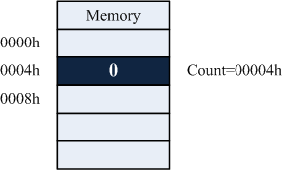
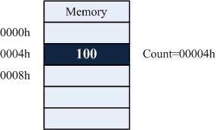
Introduction
Primitive Type
  int count=0;
  count=100;
  count=[0004h]
  [0004h]=0
  [0004h]=100;

Slide 5
Introduction
Reference Type
  Program use variables of reference types to store locations of objects in the memory.
  Such a variable is said to refer to an object .
  Reference-type instance variable are initialized by default to the value null.
  The general reference types in Java are objects and array.

Slide 6
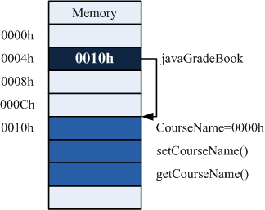
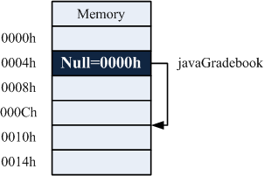
Introduction
Reference Type
javaGradeBook = new
  GradeBook();
GradeBook javaGradeBook;
javaGradeBook=[0004h]
[0004h]=0
[0004h]=0010h
attributes initialization

Slide 7
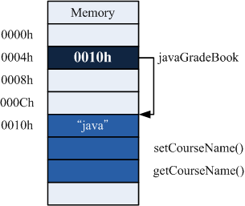
Introduction
Reference Type
javaGradeBook.CourseName=“java”
mem = [0004h]; /* mem=0010h */
mem + offset CourseName =“java”

Slide 8
Introduction
Array Description
  Array are data structures consisting of related data items of the same type.
  Arrays are the reference types that refer to array instances in memory.
  The elements of an array can be either value or reference types.

Slide 9
Introduction
Array-Access Expression
  It provides the way to access the array elements.
  Expression Constituent
    Name of Array
    Index in Square Brackets []
  The index starts from zero and must be a nonnegative integer

Slide 10
Introduction
c[ 0 ]
-45
c[ 1 ]
6
Name of array (c)
c[ 2 ]
0
c[ 3 ]
72
c[ 4 ]
1543
c[ 5 ]
-89
c[ 6 ]
0
c[ 7 ]
62
c[ 8]
-3
Position Number (index or subscript) of the element within array c
c[ 9 ]
1
c[ 10 ]
6453
c[ 11 ]
-78

Slide 11
Declaring and Creating Arrays
Array Creation Expression
  Arrays are created with keyword new
  The program specifies
    the type of array
    the number of array.
  When an array is created, each element recevies a default value.
int c[];
c = new int[12];
int[] c;
c = new int[12];
int c[] = new int[12];

Slide 12
Declaring and Creating Arrays
Array Initializier
  An array can be created and initialized its elements at the same time.
  An array initializer is a commoa-separated list of expressions enclosed in braces.
Array Length
  Every array instance has its own length which can be accessed with the length property.
int c[] = {10, 20, 30, 40, 50};
c.length

Slide 13
Declaring and Creating Arrays
public class ScoreBook {
  int m_iScoreArray[]
    = {50, 99, 40, 20, 30, 35, 90, 91, 89};
  public int Average(){
    int sum = 0;
    for(int i=0; i < m_iScoreArray.length; i++)
      sum = sum + m_iScoreArray[i];
    return sum / m_iScoreArray.length;
  }/* End of Average */
  public void DrawBar(){
  ……
  }/* End of DrawBar */
}/* End of ScoreBook */

Slide 14
Declaring and Creating Arrays
public class ScoreBook {
  public int Average(){}/* End of Average */
  public void DrawBar(){
    int countArray[] = new int[10];
    for(int i=0; i < m_iScoreArray.length; i++){
      int index = m_iScoreArray[i] / 10;
      countArray[index]++;
    }/* End of for-loop */
    System.out.println("Grade Distribution");
    for(int i=0; i < 10 ; i++){
      System.out.printf("%2d-%2d: ", i*10, i*10+9);
      for(int j=0; j < countArray[i]; j++)
        System.out.print("*");
      System.out.println();
    }/* End of for-loop */
  }/* End of DrawBar */
}/* End of ScoreBook */

Slide 15
Declaring and Creating Arrays
public class ScoreBookTest {
  public static void main(String args[]){
    ScoreBook scoreBook = new ScoreBook();
    int average = scoreBook.Average();
    System.out.printf("Average Score: %d \n", average);
    scoreBook.DrawBar();
  }/* End of main */
}/* End of ScoreBookTest */
Average Score: 60
Grade Distribution
0- 9:
10-19:
20-29: *
30-39: **
40-49: *
50-59: *
60-69:
70-79:
80-89: *
90-99: ***

Slide 16
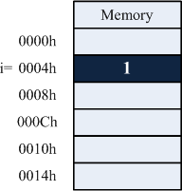
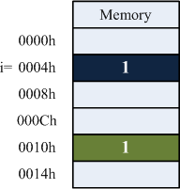
Array Passing
Argument Passing
  Pass-by-Value
    A copy of a the argument is passed to the called method
    Changes to the called method’s copy do not affect the original one.
int i =1;
Modify(i);

Slide 17
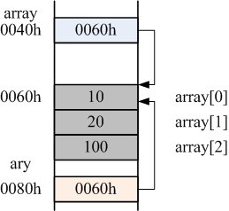
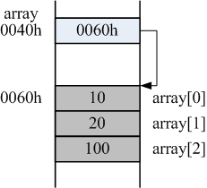
Array Passing
Argument Passing
  Pass-by-Reference
    The called method can access the argument’s value directly and modify the value.
    It improves performance by eliminating the need to copy the data.
int[] array={10,20};
Modify(array);

Slide 18
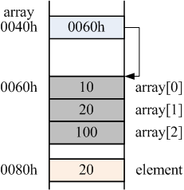
Array Passing
Passing Array Elements
  We use the indexed name as an argument.
  This is a kind of pass-by-value, that is, the change to the value can not affect the array element.
int[] array={10, 20, 100};
Modify(array[1]);
void Modify(int element){
……
}/* End of Modify */

Slide 19
Array Passing
Passing Array
  We specify the array name without any brackets.
  The called method receives the copy of the reference.
int[] array={10, 20, 100};
Modify(array);
void Modify(int[] ary){
……
}/* End of Modify */

Slide 20
Array Passing
public class PassArray {
  public void ModifyElement(int element){
    element = element * 2;
    System.out.printf("Value in ModifyElement: %d \n", element);
  }/* End of ModifyArray */
  public void ModifyArray(int array[]){
    for(int i=0; i < array.length; i++)
    array[i] = array[i] * 2;
  }/* End of ModifyArray */
}/* End of PassArray */

Slide 21
Array Passing
public class PassArrayTest {
  public static void main(String args[]){
    PassArray passArray = new PassArray();
    int array1[]={1, 2, 3, 4, 5};
    System.out.printf("Befor ModifyElement :%d \n", array1[1]);
    passArray.ModifyElement(array1[1]);
    System.out.printf("Afer ModifyElement :%d \n", array1[1]);
    int array2[]={1, 2, 3, 4, 5};
    System.out.printf("Befor ModifyArray \n");
    for(int i=0; i < array2.length; i++)
      System.out.printf("%d ", array2[i]);
    passArray.ModifyArray(array2);
    System.out.printf("\nAfter ModifyArray \n");
    for(int i=0; i < array2.length; i++)
      System.out.printf("%d ", array2[i]);
  }/* End of main */
}/* End of PassArrayTest */
Befor ModifyElement :2
Value in ModifyElement: 4
Afer ModifyElement :2
Befor ModifyArray
1 2 3 4 5
After ModifyArray
2 4 6 8 10

Slide 22
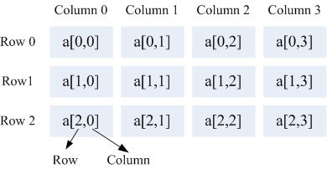
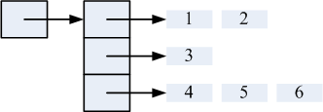
Multidimensional Arrays
Description
  It is used to represent tables of values arranged in rows and columns.
  There are two types of 2D array
Rectangular Array
Jagged Array

Slide 23

Multidimensional Arrays
Rectangular Array
  An array with m rows and n columns is called an m-by-n array.
  Array-Creation Expression
  It can be created and initializes its elements.
int c[][];
c = new int[3][4];
int c[][] = new int[3][4];
int b[][]={{1,2}, {3, 4}};

Slide 24
Multidimensional Arrays
Jagged Array
  A jagged array is a 1D array where each element refers to a 1D array.
  The lengths of the rows can be different.
  Array-Creation Expression
int c[][];
c = new int[2][];
c[0] = new int[5];
c[1] = new int[3];
int c[][]= {{1,2}, {3},
  {4, 5, 6}};

Slide 25
Multidimensional Arrays
public class InitArrayTest {
  public static void main(String args[]){
    InitArray initArray = new InitArray();
    int array1[][] = {{1,2 ,3}, {4, 5, 6}};
    System.out.println("Values in Array1");
    initArray.OutputArray(array1);
    int array2[][] = {{1,2}, {3}, {4, 5, 6}};
    System.out.println("Values in Array2");
    initArray.OutputArray(array2);
  }/* End of main */
}/* End of InitArrayTest */

Slide 26
Multidimensional Arrays
public class InitArray {
  public void OutputArray(int array[][]){
    for(int i=0; i < array.length; i++){
      for(int j=0; j < array[i].length; j++)
        System.out.printf("%d ", array[i][j]);
      System.out.println();
    }/* End of for-loop*/
  }/* End of OutputArray */
}/* End of InitArray */
Values in Array1
1 2 3
4 5 6
Values in Array2
1 2
3
4 5 6

Slide 27
Variable-Length Argument
Description
  It allows a method to receive arbitrary number of arguments.
  An argument type is followed by an ellipsis (…) in a method’s parameter list.
  The use of ellipsis can occur only in the last entry of the parameter list.
double Average(double … numbers);

Slide 28
Variable-Length Argument
public class VarArgs {
  public double Average(double... numbers){
    double sum = 0.0;
    for(int i=0; i < numbers.length; i++)
      sum += numbers[i];
    return sum / numbers.length;
  }/* End of Average */
}/* End of VarArgs */
The variable-length argument is considered as an array

Slide 29
Variable-Length Argument
public class VarArgsTest {
  public static void main(String args[]){
    VarArgs varArgs = new VarArgs();
    double d1= 10.0, d2= 20.0, d3= 30.0;
    System.out.printf("Average of d1 and d2: %f \n", varArgs.Average(d1,d2));
    System.out.printf("Average of d1, d2, and d3: %f \n", varArgs.Average(d1, d2, d3));
  }/* End of main */
}/* End of VarArgsTest */
Average of d1 and d2: 15.000000
Average of d1, d2, and d3: 20.000000

Slide 30
Thank You !
www.themegallery.com

