Slide 1

Windows Programming Using Java
Chapter3:
Introduction to Classes and Objects
Instructor: Shih-Shinh Huang

Slide 2
Contents
Introduction
Basic Object-Oriented Concept
GradeBook Example
Instance Variables
Constructors

Slide 3
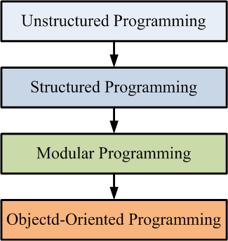
Introduction
Evolution of High-Level Language

Slide 4
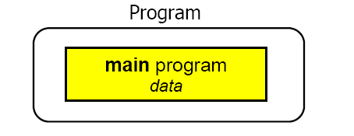
Introduction
Unstructured Programming
  The main program directly operates on the data that are declared as global variables.
  The same statement sequence must be copied if it is needed at different places.

Slide 5

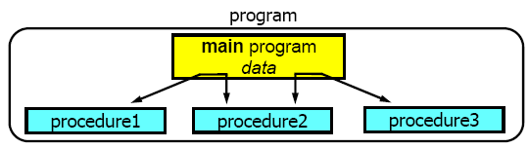
Introduction
Procedural Programming
  Combine a sequence of statements into a procedure with calls and returns.
  The main program coordinates calls to procedures and hands over data as parameters.

Slide 6
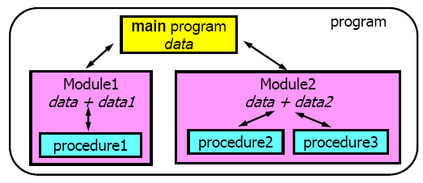
Introduction
Modular Programming
  Procedures of a common functionality are grouped together into separate modules.
  The main program coordinates calls to procedures in separate modules.

Slide 7
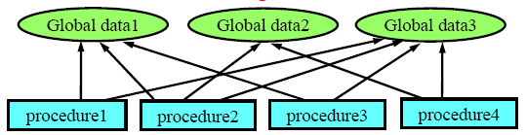
Introduction
Problems of Modular Programming
  No matter how well structured, large programs become excessively complex.
  They allow unrestricted access to global data.
  Attributes and behavior are separated such that they poorly model of the real world.

Slide 8

Basic Object-Oriented Concept
What are Classes ?
  A class is a blueprint defining the variables and methods of a kind of category.
    Variables -> States
    Methods -> Behaviors.
States (data or attributes)
Weight
Gear Implementation
Type
…..
Behaviors (operations)
Brake
Change Gear
Change Cadence
…..

Slide 9

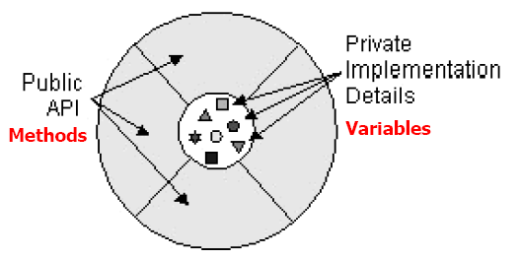



Basic Object-Oriented Concept
What are Objects?
  An object is an instance of a certain class
  An object is a software bundle of variables and related methods.

Slide 10
Basic Object-Oriented Concept
Ideas of Object-Oriented Programming
  Object-Orientation is a modeling technique that tries to imitate the way we think.
  Software objects combing both data and functions model the real-world objects.
    The data is hidden (Data Encapsulation).
    The member function is the way to interact with the data.

Slide 11
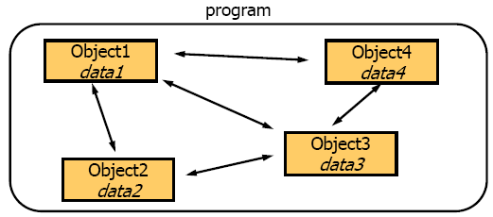
Object-Oriented Concepts
Object-Oriented Programming (OOP)
  A program is considered as a set of interacting objects.
  Objects interact to perform the task by sending messages to each other.

Slide 12
Basic Object-Oriented Concept
Benefits of OOP
  Reusability: Programmers can reuse the code in the superclass many times.
  Software Prototyping: The developed class can be considered as the software IC which makes the system development more easier and efficient.

Slide 13

Basic Object-Oriented Concept
Socket
Examples
Chat Log
Chat Dialog
AddressBook
Member
Edit Dialog
…………

Slide 14
Basic Object-Oriented Concept
Socket
Examples
Chat Log
Chat Dialog
AddressBook
Member
Edit Dialog
…………

Slide 15
Class and Instance
Class Declaration
[modifier] class ClassName {
//fields
[modifiers] type FieldName [= initial value];
//constructors
[modifiers] ClassName([arguments]){
//code
}
// methods
[modifiers] type MethodName([argument]){
//code
}
};

Slide 16
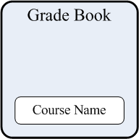
GradeBook Example
Design of GradeBook
  CourseName: attribute
    Record the name of the course.
  DisplayMessage(): method
    Display the message to the users.
    Perform the task without any arguments
    Complete the task without result returned.
  String CourseName;
  void DisplayMessage(){
  }/* End of DisplayMessage */

Slide 17
GradeBook Example
Class Declaration
  Encapsulate all the related attributes and operations into a class.
    Each class declaration contains keyword “class” followed by its name.
    Every class’s body is enclosed in a pair of left and right braces “{“, “}”.
public class GradeBook{
  String CourseName;
  Void DisplayMessage(){
  }/* End of DisplayMessage */
}/* End of class GradeBook */

Slide 18
GradeBook Example
Class Implementation
  Write the statements to perform the desired operations.
public class GradeBook{
  String CourseName;
  Void DisplayMessage(){
  System.out.println(“Welcome to Java Course!”);
  }/* End of DisplayMessage */
}/* End of class GradeBook */

Slide 19

GradeBook Example
GradeBook Tester
  A class contains main() method that is used to control the application’s execution.
  It creates a GradeBook object and uses it.
public class GradeBookTest {
  public static void main(String args[]){
  ………
  }/* End of main */
}/* End of GradeBookTest */
GradeBookTest

Slide 20

GradeBook Example
GradeBook Tester
public class GradeBookTest {
  public static void main(String args[]){
    GradeBook javaGradeBook = new GradeBook();
    javaGradeBook.DisplayMessage();
  }/* End of main */
}/* End of GradeBookTest */
new
blueprint: class
javaGradeBook:object

Slide 21
GradeBook Example
public class GradeBook{
  String CourseName;
  Void DisplayMessage(){
  System.out.println(“Welcome to Java Course!”);
  }/* End of DisplayMessage */
}/* End of class GradeBook */
public class GradeBookTest {
  public static void main(String args[]){
    GradeBook javaGradeBook = new GradeBook();
    javaGradeBook.DisplayMessage();
  }/* End of main */
}/* End of GradeBookTest */

Slide 22
GradeBook Example
Implementation without Object
public class GradeBookTest {
  public static void main(String args[]){
    String CourseName;
  DisplayMessage();
  }/* End of main */
  public void DisplayMessage(){
  System.out.println(“Welcome to Java Course!”);
  }/* End of DisplayMessage */
}/* End of GradeBookTest */

Slide 23
Instance Variables
Description
  Variables declared in the body of a particular method are known as local variables.
  Variables declared inside a class but outside the bodies of class’s method are known as fields.
  The fields in the created object represents the instance variables.
    Each object (instance) of the class has a separate instance variable in memory.

Slide 24
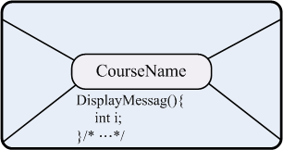

Instance Variables
public class GradeBook{
  String CourseName;
  Void DisplayMessage(){
  System.out.println(“Welcome to Java Course!”);
  }/* End of DisplayMessage */
}/* End of class GradeBook */
new
javaGradeBook:object
new
c++GradeBook:object

Slide 25
Instance Variables
Access Modifiers
  The access modifier is to identify whether the variables/methods are accessible outside.
    private: accessible only to the methods of the class
    public: accessible to the methods outside the class
  Declaring instance variables wit the private modifier is known as data hiding.
  The default modifier of Java is private.

Slide 26
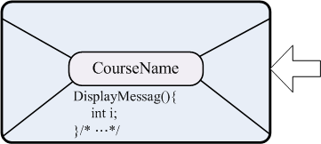
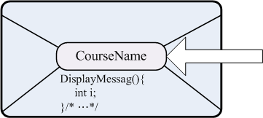
Instance Variables
public class GradeBook{
  private String CourseName;
  Void DisplayMessage(){
  ……
  }/* End of DisplayMessage */
}/* End of class GradeBook */
public class GradeBook{
  public String CourseName;
  Void DisplayMessage(){
  ……
  }/* End of DisplayMessage */
}/* End of class GradeBook */

Slide 27
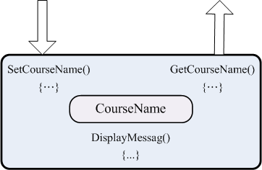
Instance Variables
Set()/Get() Method
  The fields in Java are generally designed as hiding for the purpose of data encapsulation.
  The ways to access the hiding data are through the methods.

Slide 28
Instance Variables
public class GradeBook{
  String CourseName;
  public void SetCourseName( String name ){
    courseName = name; // store the course name
  } // end method setCourseName
  public String GetCourseName(){
    return courseName;
  } // end method getCourseName
  public void DisplayMessage(){
    System.out.printf( "Welcome to the grade book for %s!\n", GetCourseName() );
  }/* End of DisplayMessage */
}/* End of GradeBook */

Slide 29
Instance Variables
public class GradeBookTest {
  public static void main(String args[]){
    GradeBook javaGradeBook = new GradeBook();
    javaGradeBook.SetCourseName("Java");
    javaGradeBook.DisplayMessage();
    GradeBook cppGradeBook = new GradeBook();
    cppGradeBook.SetCourseName("C++");
    cppGradeBook.DisplayMessage();
  }/* End of main */
}/* End of GradeBookTest */
Welcome to the grade book for Java!
Welcome to the grade book for C++!

Slide 30
Instance Variables
Implementation without Object
public class GradeBookTest {
  public static void main(String args[]){
    …………
  }/* End of main */
  public void DisplayMessage(String str){
  System.out.println(“Welcome to the grade book for %s”, str);
  }/* End of DisplayMessage */
  public void SetCourseName(String& str1, String str2){
  str1 = str2;
  }/* End of SetCourseName */
}/* End of GradeBookTest */

Slide 31
Instance Variables
Implementation without Object
public class GradeBookTest {
  public static void main(String args[]){
    String CourseName1;
    String CourseName2;
    SetCourseName1(CourseName1, “Java”);
    DisplayMessage(CourseName1);
    SetCourseName1(CourseName2, “C++);
    DisplayMessage(CourseName2);
  }/* End of main */
  public void DisplayMessage(String str){……}
  public void SetCourseName(String str1, String str2){……}
}/* End of GradeBookTest */

Slide 32
Constructor
Description
  The constructor is used to initialize the an object of a class when the object is created.
  The keyword new calls the class’s constructor to perform the initialization.
  By default, the complier provides a default constructor with no parameters.
  In default constructor, all variables are set to their default values.

Slide 33
Constructor
Declaration
  A constructor must have the same name as its class.
  Constructor cannot return values, even void.
  Normally, constructors are declared as public.
public class GradeBook{
  String CourseName;
  /* default constructor provided by compilier */
  public GradeBook() {
    courseName = NULL;
  } // end method setCourseName
}/* End of GradeBook */

Slide 34
Constructor
Declaration
  If you design your own constructor, the Java compiler will not create a default constructor.
public class GradeBook{
  String CourseName;
  /* default constructor provided by compilier */
  public GradeBook() {
    courseName = NULL;
  } // end method setCourseName
  public GradeBook(String name) {
    courseName = name;
  } // end method setCourseName */
}/* End of GradeBook */
no default constructor

Slide 35
Constructor
public class GradeBookTest {
  public static void main(String args[]){
    GradeBook javaGradeBook = new GradeBook();
    javaGradeBook.SetCourseName("Java");
    javaGradeBook.DisplayMessage();
    GradeBook cppGradeBook = new GradeBook();
    cppGradeBook.SetCourseName("C++");
    cppGradeBook.DisplayMessage();
  }/* End of main */
}/* End of GradeBookTest */
Exception in thread "main" java.lang.Error: Unresolved compilation problems:
The constructor GradeBook() is undefined
The constructor GradeBook() is undefined

Slide 36
Constructor
public class GradeBookTest {
  public static void main(String args[]){
    GradeBook javaGradeBook = new GradeBook(“Java”);
    javaGradeBook.DisplayMessage();
    GradeBook cppGradeBook = new GradeBook(“C++”);
    cppGradeBook.DisplayMessage();
  }/* End of main */
}/* End of GradeBookTest */
Welcome to the grade book for Java!
Welcome to the grade book for C++!

Slide 37
Thank You !
www.themegallery.com

