Slide 1

Windows Programming Using Java
Chapter1:
Introduction to Java Programming
Instructor: Shih-Shinh Huang

Slide 2
Contents
Syllabus
Programming Language
What is Java
Java Development Environment

Slide 3
Syllabus
Contact Information
  Name: Shih-Shinh Huang (黃世勳)
  Email : poww@ccms.nkfust.edu.tw
  Office: B322-1
  Office Hour: (三) 14:00 ~ 16:00

Slide 4
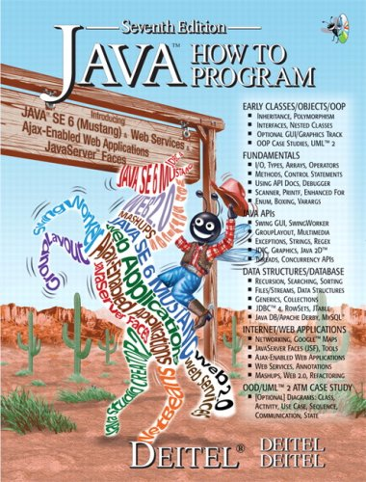
Syllabus
Textbook:
  Name: Java How to Program: Seventh Edition Edition
  Authors: P. J. Deitel and H. M. Deitel
  Publisher: Prentice Hall
  Year: 2007

Slide 5
Syllabus
Course Requirement
  Homework Assignment (about 8~10): 30%
  Two In-Class Exams: 20%
  Midterm Exam: 20%
  Final Exam: 30%
Course Rules: 1) No Roll Call, 2) No Cheat, and
3) No Bonus Point

Slide 6
Syllabus
Homework Submission
  All homework are submitted through ftp.
    Ftp IP: 163.18.59.110
    Port: 21
    User Name: Java2010
    Password: Java2010
  Scoring Rule:
grade = max(2, 10-2(delay days));

Slide 7
Syllabus
Course Outline
  Java Introduction
    Java Applications
    Control Statements
    Arrays
    Methods
  Object-Oriented Programming (OOP)
    Encapsulation
    Inheritance
    Polymorphism

Slide 8
Syllabus
Course Outline
  GUI Components
    Swing Components
    Graphics
  Advanced Topics
    Files and Streams
    Exception Handling

Slide 9
Programming Language
Description
  It is a set of instructions for commanding the computer to perform some operations.
  Programmers write various programming languages.
Language Categories
  Machine Language
  Assembly Languages
  High-Level Languages

Slide 10
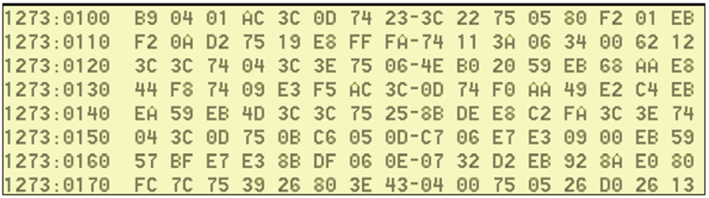
Programming Language
Machine Language
  It is a numeric language specifically understood by a computer’s processor
  Machine language is machine dependent (not portable).
  It makes humans cumbersome, slow, and error-prone to develop system.

Slide 11
Programming Language
Assembly Languages
  Represent elementary operations of computer in English-like abbreviations
  Assemblers are developed to convert assembly to machine language.
  It has a one-to-one relationship with machine language.
  1 0000 E8 MOV A,R0
  2 0001 FA MOV R2,A
  3 0002 2D ADD A,R5

Slide 12
Programming Language
High-Level Languages
  They speed up the programming process.
  Compilers convert them to machine language
  Instructions is comprehensible to humans
    Looks mostly like everyday English
    Contain common mathematical notation
  1 int sum, i, j;
  2 i=100;
  3 j=50;
  4 sum = i + j

Slide 13

What is Java?
History
  Green Project Announced by Sun in 1991
    Motivation: intelligent consumer-electronic devices
    Creator: James Gosling
    New Language: Oak
  Announcement in 1995
    Industry Conference in May 1995
    Netscape announced an agreement to integrate Java into its browser.

Slide 14
What is Java?
Properties
  It is a high-level programming language
  It is simple and purely object-oriented.
  It is portable, that is, executable at different kinds of platform.
  It is developed in world wide web applications.

Slide 15
What is Java?
Java Virtual Machine (JVM)
JAVA PROGRAM EXECUTION
Java
source code
Java
compiler
byte-code
.class
.java
byte-code
interpreter
JVM
EXECUTION

Slide 16
What is Java
Java Class Libraries
  Java has built huge amount of libraries,
  These libraries are is known as Java APIs (Application Programming Interface).
  Most of them are available over the Internet and at no charge.

Slide 17
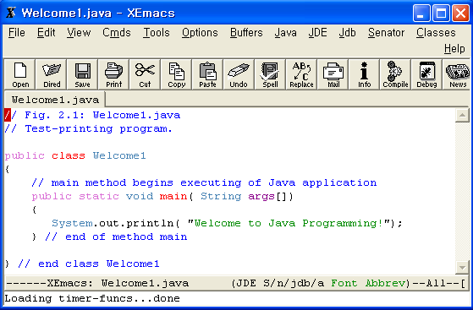
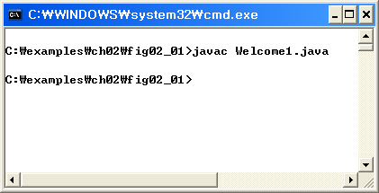
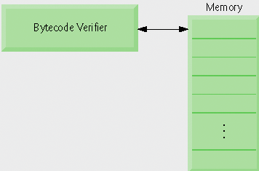

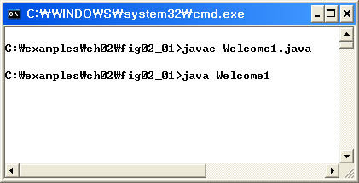


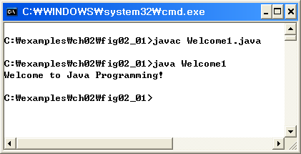
Java Development Environment
Edit
Compile
Edit & Store a file
- Extension . java
Creates bytecodes &
Stores a file
- Extension .class
Verify
Load
Verify bytecodes &
Validate for Java’s
security violations
Class loader
put . Class file
In memory
Translate bytecodes into a machine language
Execute the program
- display or store data values

Slide 18
Java Development Environment
JDK (Java Development Kit)
  Java Standard Edition (J2SE): develop client-side standalone applications or applets.
  Java Enterprise Edition (J2EE): develop server-side applications such as Java servlets.
  Java Micro Edition (J2ME): develop applications for mobile devices such as cell phones
We use J2SEDK 6.0 in this course and
you can download it from ftp site

Slide 19
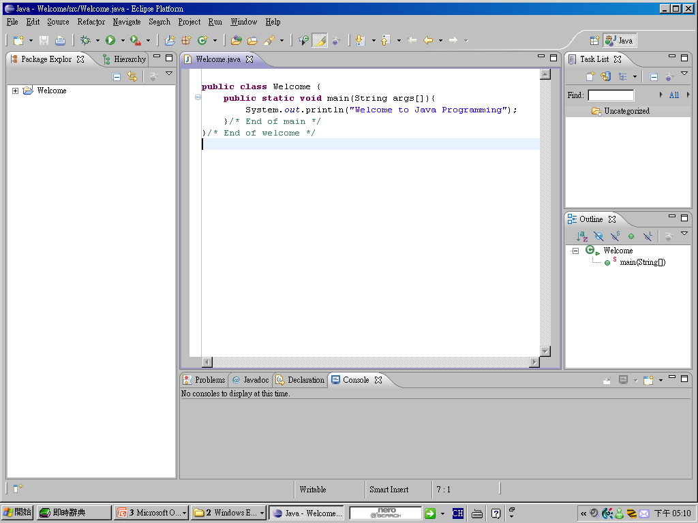

Java Development Environment
IDE (Integrated Development Environment)
  There are number of free and commercial IDEs
  We use Eclipse in this course

Slide 20
Thank You !
www.themegallery.com

