Slide 1
電腦視覺
Computer and Robot Vision I
Chapter3
Binary Machine Vision:
Region Analysis
Instructor: Shih-Shinh Huang

Slide 2
Contents
Region Properties
  Simple Global Properties
  Extremal Points
  Spatial Moments
  Mixed Spatial Gray Level Moments
Signature Properties
Contour-Based Shape Representation

Slide 3
Computer and Robot Vision I
Introduction
Region Properties

Slide 4
Introduction
Region Properties
Region Description
  Region is a segment produced by connected component labeling or signature segmentation.
  The computation of region properties can be the input for further classification.
    Gray-Level Value Analysis
    Shape Property Analysis

Slide 5
Simple Global Properties
Region Properties
Region Area
Centroid
A=21
r=3.476
c=4.095
0
1
2
3
4
5
6
7
0
0
0
0
0
0
0
0
0
1
0
0
0
0
0
0
1
0
2
0
0
1
1
1
1
1
0
3
0
0
1
1
1
0
0
0
4
0
0
1
1
1
0
0
0
5
0
1
1
1
1
1
0
0
6
0
1
1
0
0
1
1
0
7
0
0
0
0
0
0
0
0

Slide 6
Simple Global Properties
Region Properties
Perimeter Description
  It is a sequence of its interior border pixels.
  Border pixels are the pixels that have some neighboring pixel outside the region.
Types of Perimeter
  4-Connected Perimeter : Use 8-Connectivity to determine the border pixel.
  8-Connected Perimeter :Use 4-Connectivity to determine the border pixel.

Slide 7
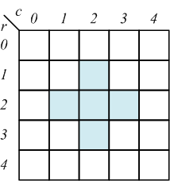
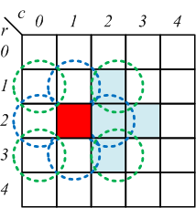
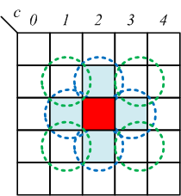
Simple Global Properties
Region Properties
4-Connected Perimeter

Slide 8
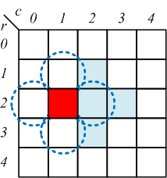
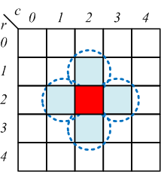
Simple Global Properties
Region Properties
8-Connected Perimeter

Slide 9
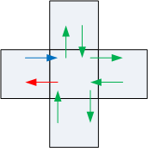
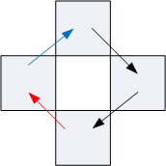
Simple Global Properties
Region Properties
Perimeter Representation
  It is a sequences of border pixels in or
    are neighborhood

Slide 10
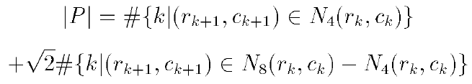
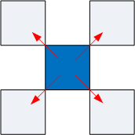
Simple Global Properties
Region Properties
Perimeter Length
Vertical or Horizontal Line
Diagonal Line

Slide 11
Simple Global Properties
Region Properties
Compactness Measure
  It is used as a measure of a shape’s compactness.
  Its smallest value is not for the digital circularity, but it would for continuous planar shapes
    Octagons
    Diamonds

Slide 12
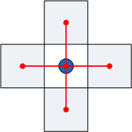
Simple Global Properties
Region Properties
Circularity Measure
  Boundary Pixels

Slide 13
Simple Global Properties
Region Properties
Circularity Measure
  Properties
    Digital shape → circular, increases monotonically.
    It is similar for similar digital/continuous shapes
    It is orientation and area independent.
  Polygon Side Estimation

Slide 14
Simple Global Properties
Region Properties
Gray-Level Mean
Gray-Level Variance
Right hand equation lets us compute variance with only one pass

Slide 15
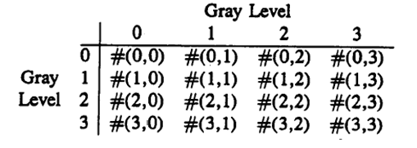
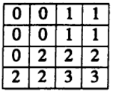
Simple Global Properties
Region Properties
Microtexture Properties
  Co-occurrence Matrix
    S : a set of all pairs of pixels that are in some defined spatial relationship (4-neighbors)

Slide 16
Simple Global Properties
Region Properties
0 1 2 3
0
1
2
3
0
DC & CV Lab.
CSIE NTU

Slide 17
Simple Global Properties
Region Properties
Microtexture Properties
  Texture Second Moment
  Texture Entropy
  Texture Homogeneity

Slide 18
Simple Global Properties
Region Properties
Microtexture Properties
  Contrast
  Correlation

Slide 19
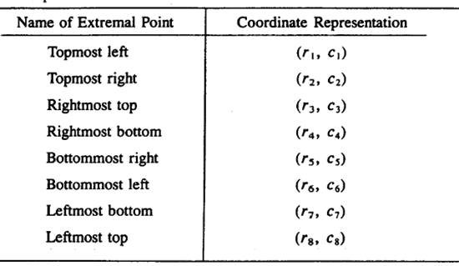
Extremal Points
Region Properties
Definition of Extremal Points
  It has an extremal coordinate value in either its row or column coordinate position
  They can be as many as eight distinct extermal points.

Slide 20
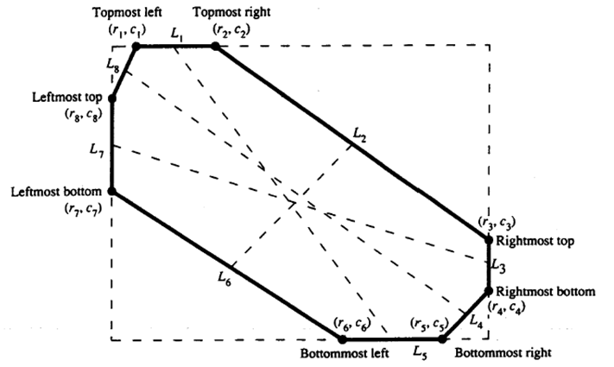
Extremal Points
Region Properties

Slide 21
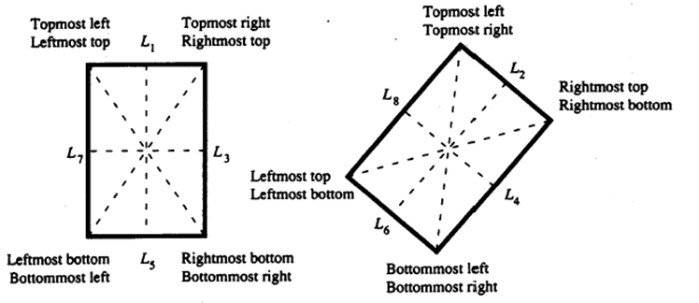
Extremal Points
Region Properties
Different extremal points may be coincident

Slide 22

Extremal Points
Region Properties
Definition of Extremal Coordinate
Topmost
Bottommost
Leftmost
Rightmost
Topmost
Leftmost
Rightmost
Bottommost

Slide 23
Extremal Points
Region Properties
Definition of Extremal Coordinate
Topmost Left
Topmost Right
Topmost Right
Topmost Left

Slide 24
Extremal Points
Region Properties
Respective Axes (M1, M2, M3, M4)
  Form by each pair of opposite extremal points
    M1: Topmost Left & Bottommost Right
    M2: Topmost Right & Bottommost Left
    M3: Rightmost Top & Leftmost Bottom
    M4: Rightmost Bottom& Leftmost Top.
  Properties
    Length
    Orientation

Slide 25
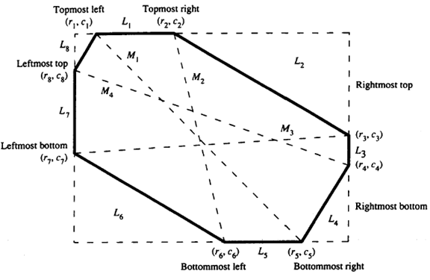
Extremal Points
Region Properties

Slide 26
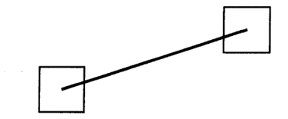
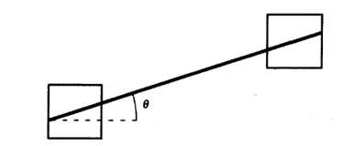
Extremal Points
Region Properties
Length of Respective Axes
  : one end point of respective axes
  : the other point of respective axes
Quantization Error
Compensation Term

Slide 27
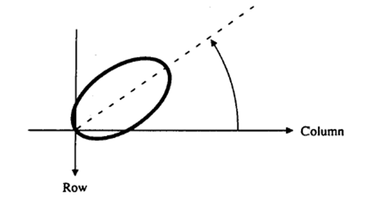
Extremal Points
Region Properties
Orientation of Respective Axes
  Orientation of a line segment is taken as counterclockwise with respect to column axis.
Quantization Error
Compensation Term

Slide 28
Extremal Points
Region Properties
Properties of Line-like Region
  Major Axis : the axis with the largest length.
  The length and orientation of major axis stands for the same thing for this region.

Slide 29
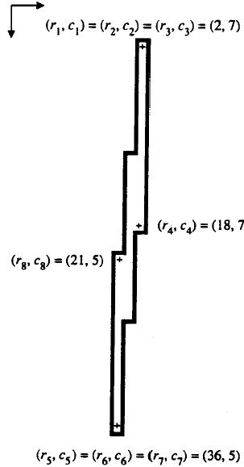


Extremal Points
Region Properties
Properties of Line-like Region

Slide 30
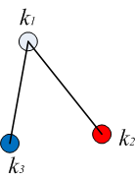
Extremal Points
Region Properties
Properties of Triangular Shapes
  Apex Selection: Find the extremal point having the greatest sum of its two largest distances.
    Extremal Point Distance
    Objective Function

Slide 31
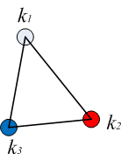
Extremal Points
Region Properties
Properties of Triangular Shapes
  Side Length
  Base Length
  Altitude Height

Slide 32
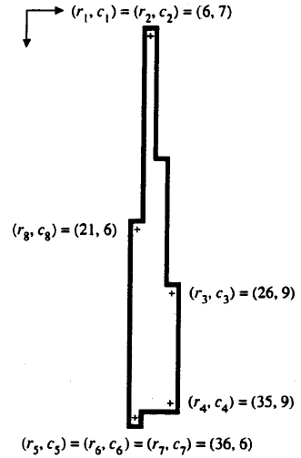
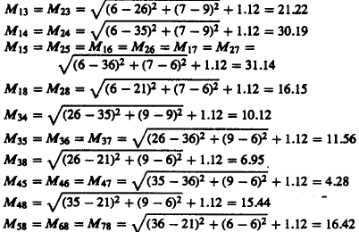
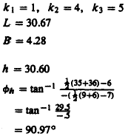
Extremal Points
Region Properties

Slide 33
Spatial Moments
Region Properties
Second-Order Spatial Moments
  Row Moment
  Mixed Moment
  Column Moment

Slide 34
Spatial Moments
Region Properties
Second-Order Spatial Moments
  They have value meaning for a region of any shape
  Similarly, the covariance matrix has value and meaning for any two-dimensional pdf.
  Example: An ellipse A whose center is the origin.

Slide 35
Mixed Spatial Gray Level Moments
Region Properties
Description
  A property that mixes up two properties.
    Spatial Properties: Region Shape, Position
    Intensity properties
  Two Second-order Mixed Spatial Gray Properties

Slide 36
Mixed Spatial Gray Level Moments
Region Properties
Application: Determine the least-square, best-fit gray level intensity plane.
  Unknowns Variables:
  Objective Function

Slide 37
Mixed Spatial Gray Level Moments
Region Properties
Application: Determine the least-square, best-fit gray level intensity plane
  Take partial derivative of with respect to
Least Square Method

Slide 38
Mixed Spatial Gray Level Moments
Region Properties
Application: Determine the least-square, best-fit gray level intensity plane

Slide 39
Mixed Spatial Gray Level Moments
Region Properties

Slide 40
Computer and Robot Vision I
Introduction
Signature Properties

Slide 41
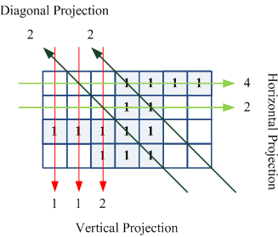
Introduction
Signature Properties
Signature Review
Remark: Signature analysis is important
because of easy, fast implementation in pipeline hardware

Slide 42
Signature Computation
Signature Properties
Centroid
Second-Order Moment

Slide 43
Signature Computation
Signature Properties
Second-Order Moment

Slide 44
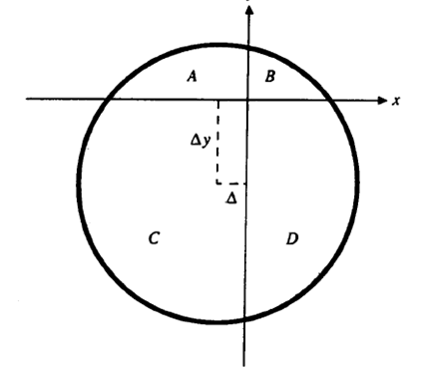
Circle Center Determination
Signature Properties
Description
  We can determine the center position of circular region from signature analysis.

Slide 45
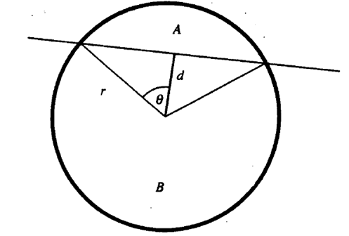
Circle Center Determination
Signature Properties
Derivation

Slide 46
Circle Center Determination
Signature Properties
Derivation
Compute by a table-look-up technique

Slide 47
Circle Center Determination
Algorithm
  Step 1: Partition the circuit into four quadrants formed by two orthogonal lines intersecting inside the circle.
  Step 2: Using signature analysis to compute the areas A, B, C, and, D.
  Step 3: Compute using the derived equation.

Slide 48
Computer and Robot Vision I
Introduction
Contour-Based
Shape Representation

Slide 49
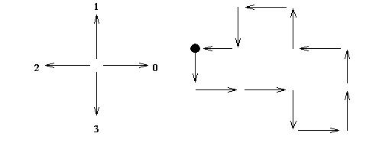
Chain Code
Description
  It describes an object by a sequence of unit-size line segment with a given orientation.
  The first element must bear information about its position to permit region reconstruction.
Chain Code: 3, 0, 0, 3, 0, 1, 1, 2, 1, 2, 3, 2

Slide 50
Chain Code
Matching Requirement
  It must be independent of the choice of the first border pixel in the sequence.
  It requires the normalization of chain code
    Interpret the chain code as a base 4 number.
    Find the pixel in the border sequence which results in the minimum integer number.
Chain Code: (300301121232)4
Chain Code: (003011212323)4

Slide 51
Curvature
Description
  Curvature is defined as the rate of change of slope in the continuous case.
  The evaluation algorithm in the discrete case is based on the detection of angles between two lines.
  Values of the curvature at all boundary pixels can be represented by a histogram for matching.

Slide 52
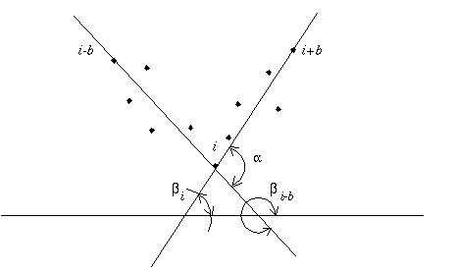
Curvature
b: sensitivity to local changes.

Slide 53
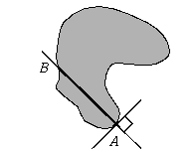
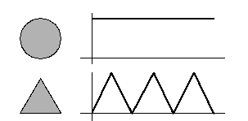
Signature
Description
  The signature is a sequence of normal contour distances.
  It can be calculated for each boundary elements as a function of the path length.

Slide 54
Chord Distribution
Description
  Chord is a line joining any two points of the region boundary.
  The distribution of lengths and angles of all chords may be used for shape description.
Definition of Chord Distribution
  : contour points
  : all other points

Slide 55
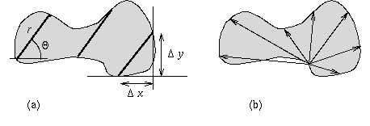
Chord Distribution
Rotation-Independent Radial Distribution

Slide 56
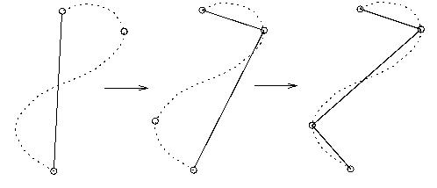
Segment Sequence
Description
  It is a way to represent the boundary using segments with specified properties.
Recursive Boundary Splitting

Slide 57
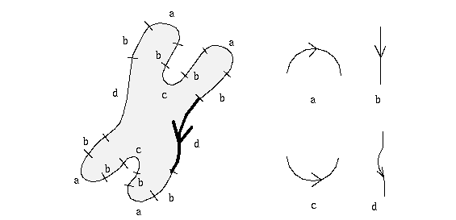
Segment Sequence
Structure Description
  Curves are segmented into several types
    Circular Arcs
    Straight Line
  Segments are considered as primitives for syntactic shape recognition
Chromosomes Representation.

Slide 58
Scale-Space Image
Description
  Sensitivity of shape descriptors to scale (image resolution) is an undesirable feature.
  Some curve segmentation points exist in one resolution and disappear in others.
Approach Properties
  Only new segmentation points can appear at higher resolution.
  No existing segmentation points can disappear.

Slide 59
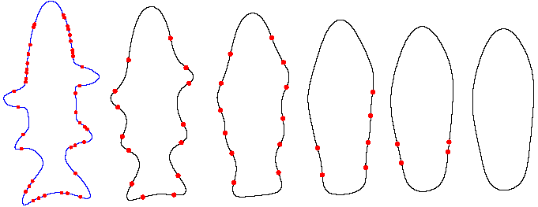
Scale-Space Image
Approach Description
  It is based on application of a unique Gaussian smoothing kernel to a one-dimensional signal.
  The zero-crossing of the second derivative is detected to determine the peak of curvature.
  The positions of zero-crossing give the positions of curve segmentation points.

Slide 60
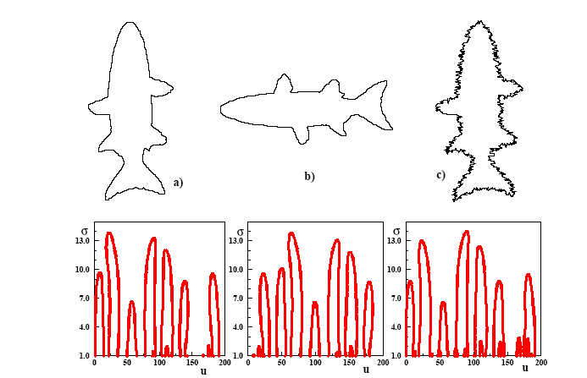
Scale-Space Image

Slide 61
Computer and Robot Vision I
The End

