Slide 1
Chapter 3:
Input and Interaction
Instructor: Shih-Shinh Huang
www.themegallery.com

Slide 2
Outlines
Introduction
Event-Driven Input Programming
Graphical User Interface: Menu
Animating Interactive Program
Logical Operation

Slide 3
Introduction
Basic Interactive Paradigm
  It is established by Ivan Sutherland (MIT 1963) to characterize interactive computer graphics
    Step 1: User sees an object on the display
    Step 2: User points to (picks) the object with an input device (light pen, mouse, trackball)
    Step 3: Object changes (moves, rotates, morphs)
    Step 4: Return to Step 1.

Slide 4
Introduction
Input Devices
  The input devices can be considered in two distinct ways.
    Physical Devices: is the way that we take to look
    Logical Devices: is to treat the devices in terms of what they do from the perspective of the program.

Slide 5
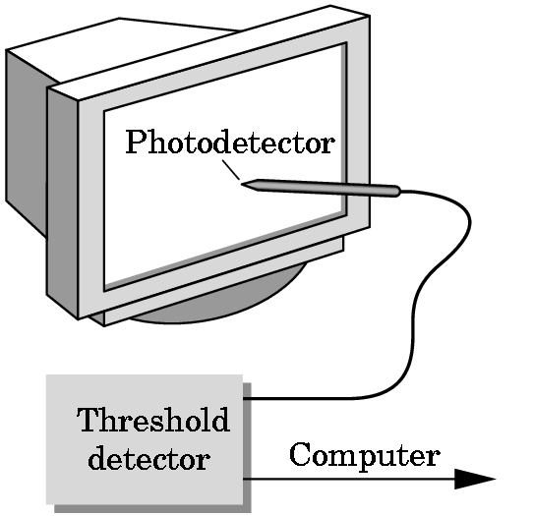
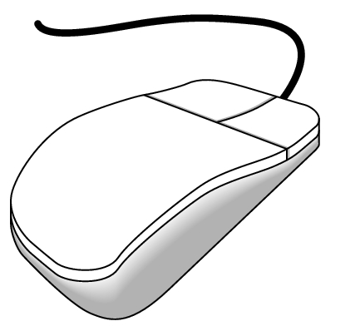
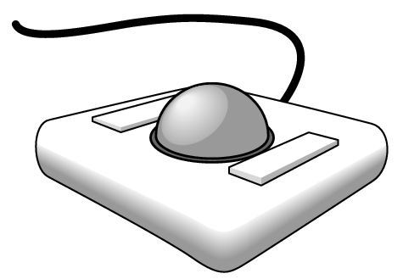
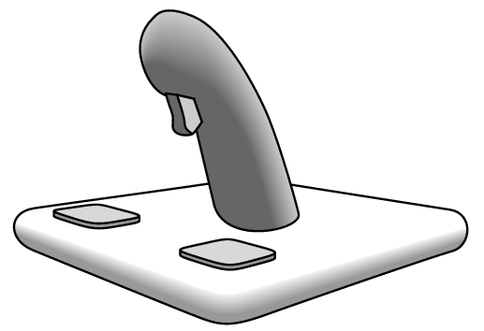
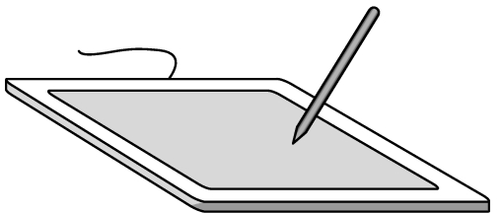
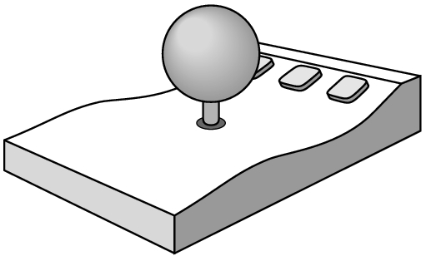
Introduction
Physical Devices
mouse
trackball
light pen
data tablet
joy stick
space ball

Slide 6
Introduction
Logical Device
  The behavior of the logical devices is characterized by two factors.
    Measurement.
    Time to return the measurement.
  Six Types
    String: ASCII strings
    Locator: position
    Pick: identifier of an object
    Choice: one of the discrete items
    Valuator: return floating point number
    Stroke: return array of positions

Slide 7
Introduction
Input Modes
  It can be described in terms of two entities
    Measure Process: is what the device returns
    Trigger Process: is a physical input device that the user can signal the computer.
  We can obtain the measure of a device in the three Modes
    Request Mode
    Sample Mode
    Event Mode

Slide 8
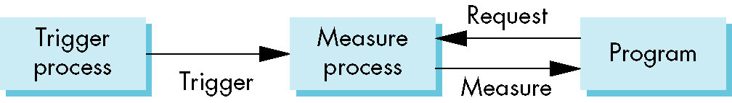
Introduction
Input Modes
  Request Mode
    The measure of the device is not returned to the program until the device is triggered.
    Example: The user can erase, edit, or correct until enter (return) key (the trigger) is depressed

Slide 9

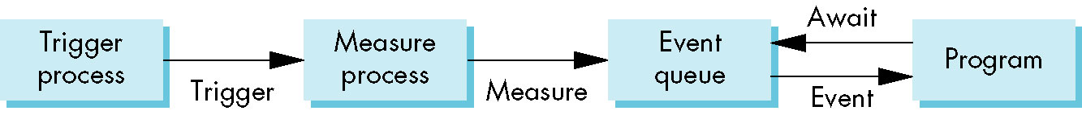
Introduction
Input Modes
  Sample Mode
    The measure is returned as soon as the function call is encountered.
  Event Mode
    Each input device can be triggered at an arbitrary time by a user.
    Each trigger generates an event whose measure is put in an event queue.

Slide 10
Event-Driven Input Programming
Introduction
  The event-driven input is developed through the callback mechanism
    Window: resize, expose, iconify
    Mouse: click one or more buttons
    Motion: move mouse
    Keyboard: press or release a key
    Idle: nonevent

Slide 11
Event-Driven Input Programming
Pointing Device: Mouse Callback
  Setting: glutMouseFunc(mymouse)
  Prototype:
    button: GLUT_LEFT_BUTTON, GLUT_MIDDLE_BUTTON, GLUT_RIGHT_BUTTON
    state: GLUT_UP, GLUT_DOWN
    x, y: position in window
void myMouse(GLint button, GLint state, GLint x, GLint y)

Slide 12
Event-Driven Input Programming
Keyboard Events: glutKeyboardFunc()
  Trigger Situations
    The mouse is in the window
    One of the keys is pressed.
  Measurements
    ASCII Code of the Key
    Mouse Location
void mykeyboard(unsinged char key, GLint x, GLint y)

Slide 13
Event-Driven Input Programming
Keyboard Events:
  A function glutGetModifiers() can be used to get the meta keys, such as Control, Alt keys.
glutKeyboardFunc(myKeyboard);
void myKeyboard(unsigned char key, int x, int y){
if(key == 'q' || key == 'Q') exit(0);
}/* End of myKeyboard */
Example: Exit the Program

Slide 14
Event-Driven Input Programming
Window Resizing Event:glutReshapeFunc()
  It is triggered when the size of window is changed.
  Issues
    Do we redraw all the objects?
    What do we do if the aspect ratio of the new window is different from the old one?
    Do we change the sizes of attributes of new primitives?
There is no single answer to any of these questions.

Slide 15
Event-Driven Input Programming
Window Resizing Event:glutReshapeFunc()
void myReshape(int width, int height){
/* set the sub menu */
glMatrixMode(GL_PROJECTION);
glLoadIdentity();
gluOrtho2D(0.0, width, 0.0, height);
glMatrixMode(GL_MODELVIEW);
glLoadIdentity();
/* set the main menu */
glViewPort(0, 0, width, height);
}/* End of myReshape */

Slide 16
Event-Driven Input Programming
Display & Idle Callback
  Display Callback: glutDisplayFunc()
    This callback can be invoked in different way to avoid unnecessary drawings.
  Idle Callback
    It is invoked when there are no other events.
    The default of idle callback is NULL.
glutPostRedisplay();

Slide 17
Event-Driven Input Programming
Callback Enable and Disable
  The callback function can be changed during the program execution.
  We can disable a callback function by setting its callback function to NULL
void myMouse(int button, int state, int x, int y){
if(button == GLUT_RIGHT_BUTTON && state == GLUT_DOWN)
glutIdleFunc(NULL);
}/* End of myKeyboard */

Slide 18
Event-Driven Input Programming
int main(int argc, char** argv){
  /* initialize the interaction */
  glutInit(&argc, argv);
  /* specify the window properties and create window */
  ………
  glutDisplayFunc(myDisplay);
  glutIdleFunc(myIdle);
  glutKeyboardFunc(myKeyboard);
  glutMouseFunc(myMouse);
  glutReshapeFunc(myReshape);
  myInit();
  /* start to run the program */
  glutMainLoop();
}/* End of main */

Slide 19
Graphical User Interface: Menu
Menu Description
  GLUT provides pop-up menus for users to create sophisticated interactive applications.
  The menus can be developed in a hierarchical manner.
Development Steps
  Register a callback function to each menu
  Add the items to the menu
  Link the menu to a particular mouse button.

Slide 20
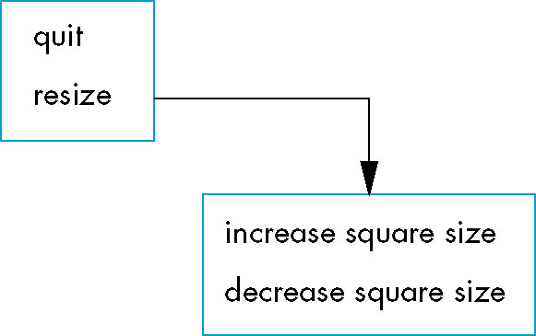
Graphical User Interface: Menu
Example:
void myInit(){
/* set the sub menu */
int sub_menu = glutCreateMenu(mySubMenu);
glutAddMenuEntry("Increase Square Size", 2);
glutAddMenuEntry("Decrease Square Size", 3);
/* set the main menu */
glutCreateMenu(myMenu);
glutAddMenuEntry("Quit", 1);
glutAddSubMenu("Resize", sub_menu);
glutAttachMenu(GLUT_RIGHT_BUTTON);
}/* End of myInit */
Callback Function
Callback Function

Slide 21
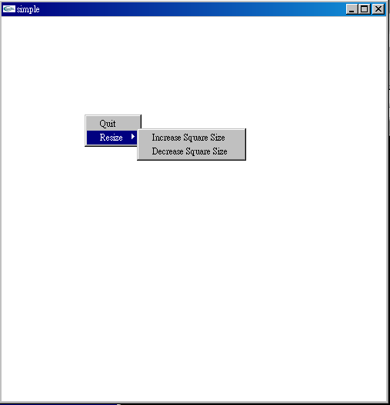
Graphical User Interface: Menu
Example:
void myMenu(int id){
switch(id){
case 1: exit(0);
}/* End of switch */
}/* End of myMenu */
void mySubMenu(int id){
}/* End of myMenu */

Slide 22
Animating Interactive Program
Description
  The function of animation is to create a picture where one or more objects are moving.
  It is an important part of computer graphics.
  Examples
    An animated character walks across the display
    We may move the view over time.

Slide 23
Animating Interactive Program
Animation in Movie
  Motion is achieved by taking a sequence of pictures and projecting them at 24 frames/sec.
    Step1: Each frame is moved to into position behind the lens.
    Step2: The shutter is opened and frame is displayed.
    Step3: The shutter is momentarily closed.
    Step4: Go to Step 1.
The key reason that motion picture projection works is
that each frame is complete when it is displayed.

Slide 24
Animating Interactive Program
Animation Problem
Open_Window();
for(int i=0; i < 1000000; i++){
  Clear_Window();
  Draw_Frame(i);
  Wait();
}/* End of for-loop */
Problem: it doesn’t display completely drawn frames;
instead, you watch the drawing as it happens

Slide 25
Animating Interactive Program
Double Buffering
  Hardware/Software supplies two complete color buffers.
    Front Buffer: the one for displaying
    Back Buffer: the one for drawing.
  The objective is to redisplay efficiently so that we can’t notice the clearing and redrawing.
    One manifestation occurs if the display cannot be drawn in a single refresh cycle.

Slide 26
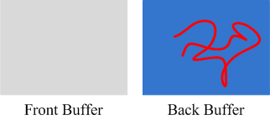

Animating Interactive Program
Double Buffering
  Remark: It does not speed up the drawing process, it only ensures that we never see a partial display.
Motion = Redraw + Swap

Slide 27
Animating Interactive Program
Double Buffering
Open_Window(Double_Buffer);
for(int i=0; i < 1000000; i++){
  Clear_Window();
  Draw_Frame(i);
  Swap_Buffer();
}/* End of for-loop */
OpenGL:
glutInitDisplayMode (GLUT_RGB | GLUT_DOUBLE)
glutSwapBuffers(): swap these two buffers.

Slide 28
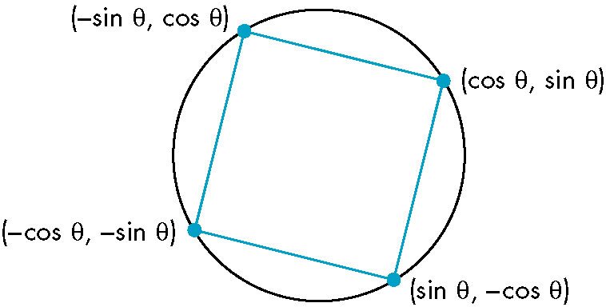
Animating Interactive Program
Example: Rotating Square
  Draw a square rotating on the screen
  Rotation Start: press the left button of mouse.
  Rotation Stop: press the right button of mouse.

Slide 29
Animating Interactive Program
Example: Rotating Square
/* callback functions */
void myDisplay(); /* display callback */
void myIdle(); /* idle callback */
void myKeyboard(unsigned char, int, int);/* keyboard callback */
void myMouse(int, int, int, int); /* mouse callback */
void myTimer(int); /* timer callback */
/* member function */
void myInit();
void mySpin();
/* attribute */
float theta = 0.0;

Slide 30
Animating Interactive Program
int _tmain(int argc, char** argv){
glutInit(&argc, argv);
glutInitDisplayMode(GLUT_RGB | GLUT_DOUBLE);
glutInitWindowSize(500, 500);
glutInitWindowPosition(0, 0);
glutCreateWindow("Double Buffer");
glutDisplayFunc(myDisplay);
glutMouseFunc(myMouse);
myInit();
glutMainLoop();
return 0;
}/* End of main */

Slide 31
Animating Interactive Program
void myMouse(int button, int state, int x, int y){
  switch (button) {
    case GLUT_LEFT_BUTTON:
    if (state == GLUT_DOWN)
      glutIdleFunc(mySpin);
    break;
    case GLUT_MIDDLE_BUTTON:
    case GLUT_RIGHT_BUTTON:
      if (state == GLUT_DOWN)
        glutIdleFunc(NULL);
      break;
    default:
      break;
  }/* End of switch */
}/* End of GasketDisplay */

Slide 32
Animating Interactive Program
void mySpin(void){
/* increase the theta */
theta += 2; /* increase 2 degree */
if(theta >= 360.0) theta = 0.0;
glutPostRedisplay();
}/* End of mySpin */

Slide 33
Animating Interactive Program
Example: Rotating Square
void myDisplay(){
glClear(GL_COLOR_BUFFER_BIT);
float thetar = theta * 3.14159 / (180);
glBegin(GL_POLYGON);
glVertex2f(cos(thetar), sin(thetar));
glVertex2f(sin(thetar), -cos(thetar));
glVertex2f(-cos(thetar), -sin(thetar));
glVertex2f(-sin(thetar), cos(thetar));
glVertex2f(cos(thetar), sin(thetar));
glEnd();
glFlush();
glutSwapBuffers();
}/* End of GasketDisplay */

Slide 34
Animating Interactive Program
Timer
  The objective is to avoid the blur effect of the display due to many redrawing.
  The timer is used to control the redrawing times per second.
  Timer Callback
    Execution of this function starts a timer to delay the event loop for “delay” milliseconds.
    When timer has counted down, callback is invoked.
glutTimerFunc(int delay,
void(*timer_func)(int), int value);

Slide 35
Animating Interactive Program
Timer
  Because GLUT allows only a single timer, the recursive mechanism should be used to execute the callback.
void myTimer(int value){
  glutTimerFunc(1000/value, myTimer, value);
}/* End of myTimer */

Slide 36
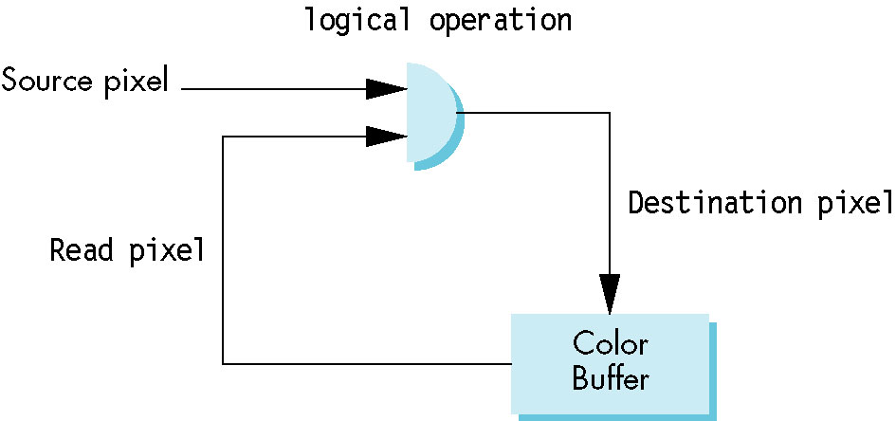
Logical Operation
Description
  The logical operations are the ways to combine the source and destination pixels.
    Source Pixel: the pixel that we want to write
    Destination Pixel: the pixel in the drawing buffer that the source pixel will affect.

Slide 37
Logical Operation
Description
  There are 16 possible functions between two bits.
  Each function defines a writing mode.
Writing Mode
  Replacement/Copy Mode
    It is the default mode of OpenGL
    It replaces the destination pixel with source one.
  XOR Mode
    It combines two bits through exclusive operation

Slide 38
Logical Operation
Mode Change Operators
glEnable(GL_COLOR_LOGIC_OP);
glLogicOp(GL_XOR);
glEnable(GL_COLOR_LOGIC_OP);
glLogicOp(GL_COPY)
glBegin(GL_POLYGON);
  glVertex2f(cos(thetar), sin(thetar));
  glVertex2f(sin(thetar), -cos(thetar));
  glVertex2f(-cos(thetar), -sin(thetar));
glEnd();
glLogicOp(GL_XOR);

Slide 39
Logical Operation
XOR Mode
  We return to the original state, if we apply xor operation twice.
  It is generally used for erasing objects by simply drawing it a second time.

Slide 40
Thank You !

