Slide 1
Chapter 2:
Graphics Programming
Instructor: Shih-Shinh Huang
www.themegallery.com

Slide 2
Outlines
Introduction
OpenGL API
Primitives and Attributes
OpenGL Viewing
Sierpinski Gasket Example
Implicit Functions Plotting

Slide 3

Introduction
Graphics System
  The basic model of a graphics package is a black box described by its input and output.
  Input Interface
    Function Calls from User Program
    Measurements from Input Devices
  Output Interface
    Graphics to Output Device.

Slide 4
Introduction
Graphics System
  API Categories
    Primitive Functions
    Attribute Functions
    Viewing Functions
    Transformation Functions
    Input Functions
    Control Functions
    Query Functions

Slide 5
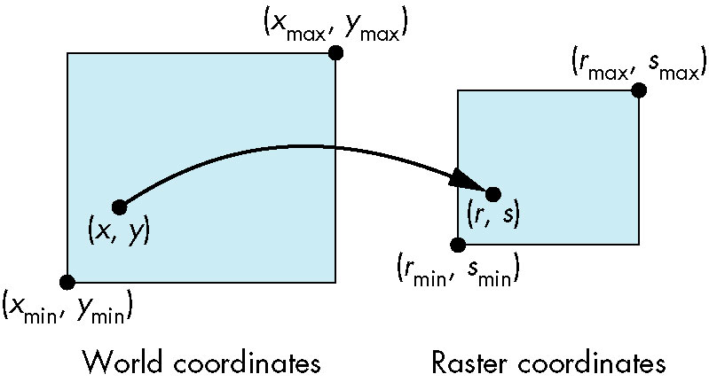
Introduction
Coordinate System
  It is difficult to specify the vertices in units of the physical device.
  Device-independent graphics makes users easy to define their own coordinate system
    World Coordinate System
    Application Coordinate System.
Rendering Process

Slide 6
Introduction
Running OpenGL on Windows VC++
  Step 1: Download the GLUT for windows from website.
  Step 2: Put the following files in the locations
    glut32.dll -> C:\windows\system32
    glut32.lib -> <VC Install Dir>\lib
    glut.h -> <VC Install Dir>\include
  Step 3: Create a VC++ Windows Console Project
  Step 4: Add a C++ File to the created project
  Step 5: Add opengl32.lib glu32.lib glut32.lib to
    Project->Properties->Configuration Properties->Linker->Input->Additional Dependencies

Slide 7
OpenGL API
What is OpenGL (Open Graphics Library)
  It is a layer between programmer and graphics hardware.
  It is designed as hardware-independent interface to be implemented on many different hardware platforms
  This interface consists of over 700 distinct commands.
    Software library
    Several hundred procedures and functions

Slide 8
OpenGL API
What is OpenGL
Applicaton
Applicaton
Graphics Package
OpenGL Application Programming Interface
Hardware and software
Output Device
Input Device
Input Device

Slide 9
OpenGL API
Library Organization
  OpenGL (GL)
    Core Library
    OpenGL on Windows.
  OpenGL Utility Library (GLU)
    It uses only GL functions to create common objects.
    It is available in all OpenGL implementations.
  OpenGL Utility Toolkit (GLUT)
    It provides the minimum functionalities expected for interacting with modern windowing systems.

Slide 10
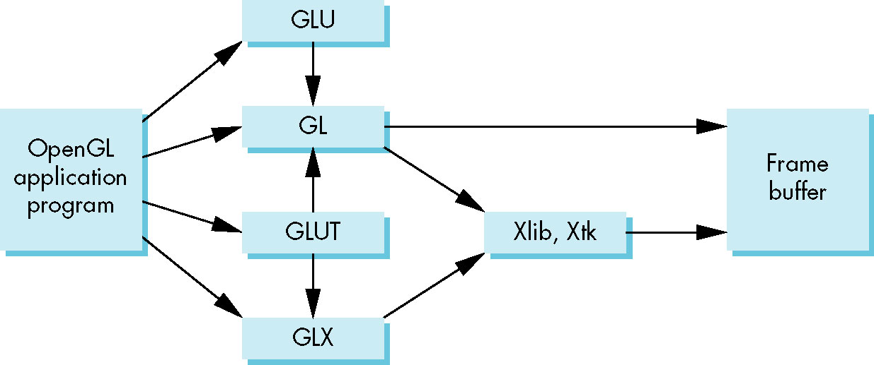
OpenGL API
Library Organization
GLX for X window systems
WGL for Windows
AGL for Macintosh

Slide 11
OpenGL API
Program Structure
  Step 1: Initialize the interaction between windows and OpenGL.
  Step 2: Specify the window properties and further create window.
  Step 3: Set the callback functions
  Step 4: Initialize the program attributes
  Step 5: Start to run the program

Slide 12
OpenGL API
Program Framework
includes gl.h
#include <GL/glut.h>
int main(int argc, char** argv)
{
glutInit(&argc,argv);
glutInitDisplayMode(GLUT_SINGLE|GLUT_RGB);
glutInitWindowSize(500,500);
glutInitWindowPosition(0,0);
glutCreateWindow("simple");
glutDisplayFunc(myDisplay);
myInit();
glutMainLoop();
}
interaction initialization
define window properties
display callback
set OpenGL state
enter event loop

Slide 13
OpenGL API
Program Framework: Window Management
  glutInit():initializes GLUT and should be called before any other GLUT routine.
  glutInitDisplayMode():specifies the color model (RGB or color-index color model)
  glutInitWindowSize(): specifies the size, in pixels, of your window.
  glutInitWindowPosition():specifies the screen location for the upper-left corner
  glutCreateWindow():creates a window with an OpenGL context.

Slide 14
OpenGL API
Program Framework
void myInit(){
/* set colors */
glClearColor(1.0, 1.0, 1.0, 0.0);
}/* End of myInit */
void myDisplay(){
/* clear the display */
glClear(GL_COLOR_BUFFER_BIT);
glFlush();
}/* End of GasketDisplay */

Slide 15
OpenGL API
Program Framework: Color Manipulation
  glClearColor():establishes what color the window will be cleared to.
  glClear():actually clears the window.
  glColor3f():establishes what color to use for drawing objects.
  glFlush():ensures that the drawing command are actually executed.
Remark: OpenGL is a state machine. You put it into various states or modes that remain in effect until you change them

Slide 16
Primitives and Attributes
Primitive Description
  An API should contain a small set of primitives that the hardware can be expected to support.
  The primitives should be orthogonal.
OpenGL Primitive
  Basic Library: has a small set of primitives
  GLU Library: contains a rich set of objects derived from basic library.

Slide 17
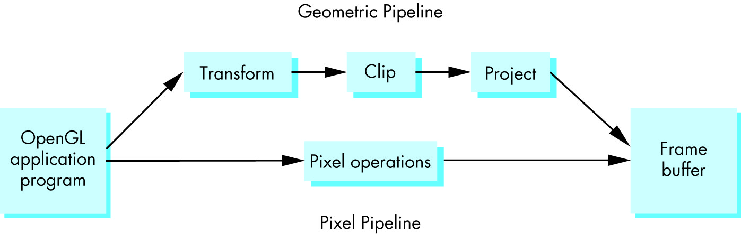
Primitives and Attributes
Primitive Classes
  Geometric Primitives
    They are subject to series of geometric operations.
    They include points, line segments, curves, etc.
  Raster Primitives
    They are lack of geometric properties
    They may be array of pixels.

Slide 18
Primitives and Attributes
Program Form of Primitives
  The basic ones are specified by a set of vertices.
  The type specifies how OpenGL assembles the vertices.
glBegin(type);
glVertex*(…);
glVertex*(…);
.
.
glVertex*(…);
glEnd();

Slide 19
Primitives and Attributes
Program Form of Primitives
  Vertex Function: glVertex*()
    * : can be as the form [nt | ntv]
    n : the number of dimensions (2, 3, 4)
    t : data type (i: integer, f: float, and d: double)
    v : the variables is a pointer.
glVertex2i (GLint x, GLint y);
glVertex3f(GLfloat x, GLfloat y, GLfloat z);
glVertex2fv(p); // int p[2] = {1.0, 1.0}

Slide 20
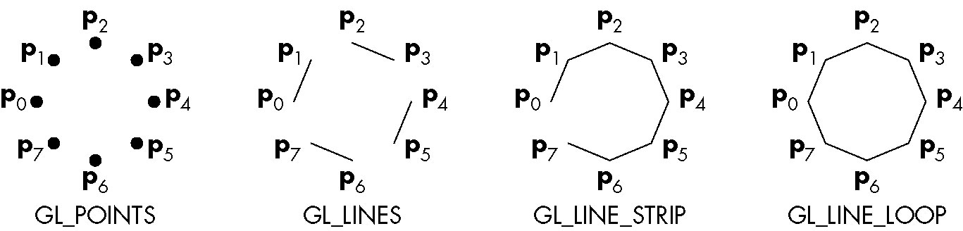
Primitives and Attributes
Points and Line Segment
  Point: GL_POINTS
  Line Segments: GL_LINES
  Polygons:
    GL_LINE_STRIP
    GL_LINE_LOOP

Slide 21

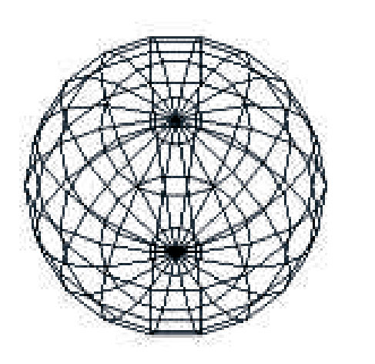
Primitives and Attributes
Polygon Definition
  It is described by a line loop
  It has a well-defined interior.
Polygon in Computer Graphics
  The polygon can be displayed rapidly.
  It can be used to approximate arbitrary surfaces.

Slide 22
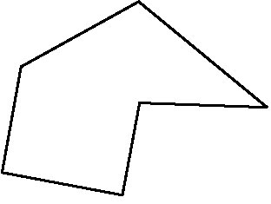
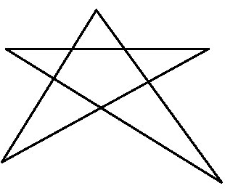
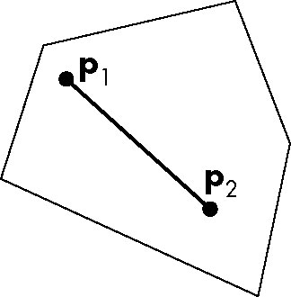
Primitives and Attributes
Polygon Properties
  Simple: no two edges cross each other
  Convex: all points on the line segment between two points inside the object.
  Flat: any three no-collinear determines a plane where that triangle lies.
Simple
Non-Simple
Convexity

Slide 23
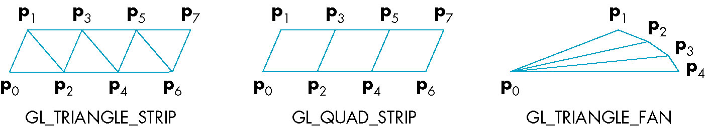
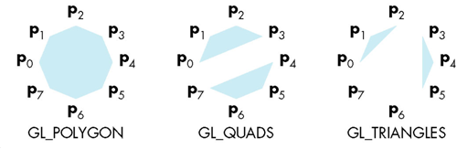
Primitives and Attributes
Polygon Primitives
  Polygons: GL_POLYGON
  Triangles: GL_TRIANGLES
  Quadrilaterals: GL_QUADS
  Stripes: GL_TRIANGLE_STRIP
  Fans: GL_TRIANGLE_FAN

Slide 24
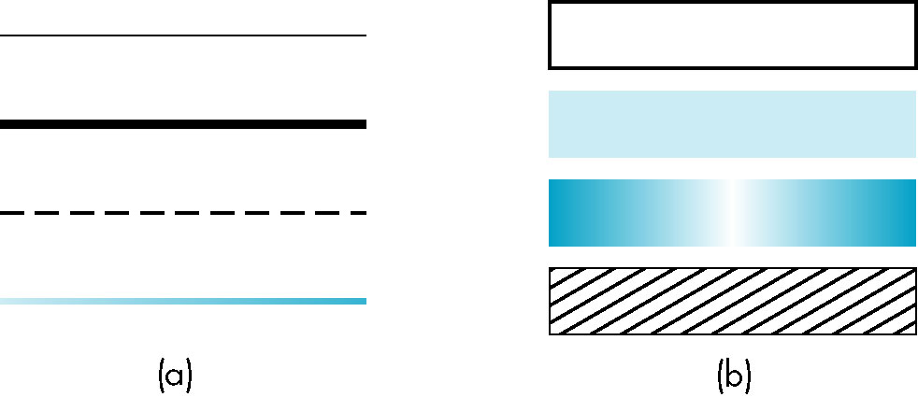
Primitives and Attributes
Attributes
  An attribute is any property that determines how a geometric primitive is to be rendered.
  Each geometric primitive has a set of attributes.
    Point: Color
    Line Segments: Color, Thickness, and Pattern
    Polygon: Pattern

Slide 25
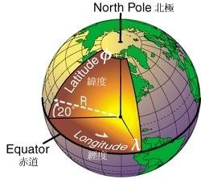
Primitives and Attributes
Example: Sphere Approximation
  A set of polygons are used to construct an approximation to a sphere.
    Longitude
    Latitude

Slide 26
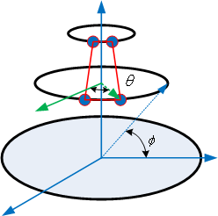
Primitives and Attributes
Example: Sphere Approximation
  We use quad strips primitive to approximate the sphere.

Slide 27
Primitives and Attributes
void myDisplay(){
/* clear the display */
glClear(GL_COLOR_BUFFER_BIT);
for(phi=-80; phi <= 80; phi+=20.0){
glBegin(GL_QUAD_STRIP);
phi20 = phi+20;
phir = (phi * 3.14159 / 180);
phir20 = (phi20 * 3.14159 / 180);
for(theta=-180; theta <= 180; theta += 20){
}/* End of for-loop */
glEnd();
}/* End for-loop */
glFlush();
}/* End of Sphere */

Slide 28
Primitives and Attributes
thetar = (theta * 3.14159 / 180);
/* compute the point coordinate */
x = sin(thetar)*cos(phir);
y = cos(thetar)*cos(phir);
z = sin(phir);
glVertex3d(x,y,z);
x = sin(thetar)*cos(phir20);
y = cos(thetar)*cos(phir20);
z = sin(phir20);
glVertex3d(x,y,z);

Slide 29
Primitives and Attributes
Color
  From the programmer’s view, the color is handled through the APIs.
  There are two different approaches
    RGB-Color Model
    Index-Color Model
  Index-Color model is easier to support in hardware implementation
    Low Memory Requirement
    Limited Available Color

Slide 30
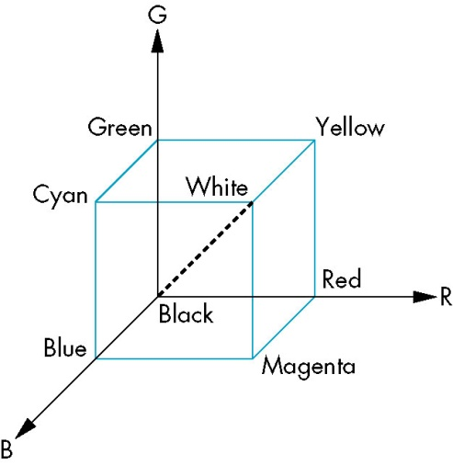
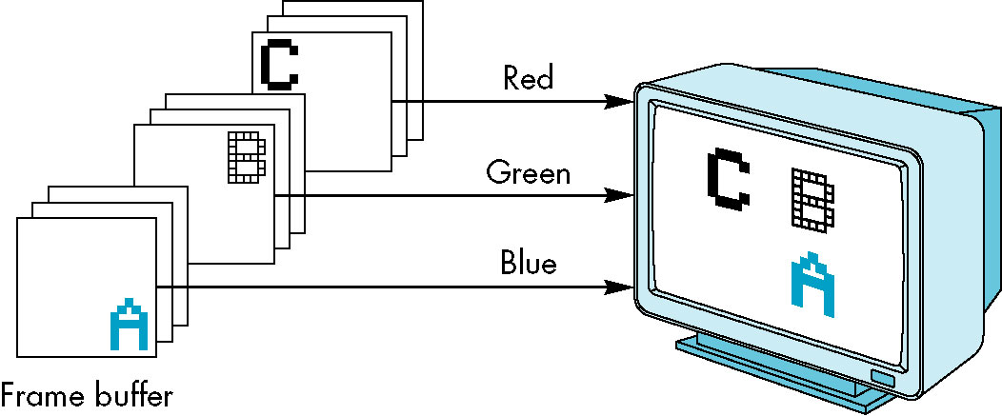
Primitives and Attributes
RGB-Model
  Each color component is stored separately in the frame buffer
  For hardware independence consideration, color values range from 0.0 (none) to 1.0 (all),

Slide 31
Primitives and Attributes
RGB-Model
  Setting Operations
  Clear Color Setting
    Transparency: alpha = 0.0
    Opacity: alpha = 1.0;
glColor3f(r value, g value, b value);
glClearColor(r value, g value, b value, alpha);

Slide 32
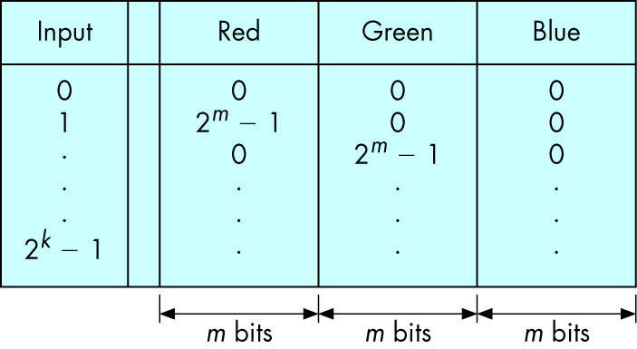
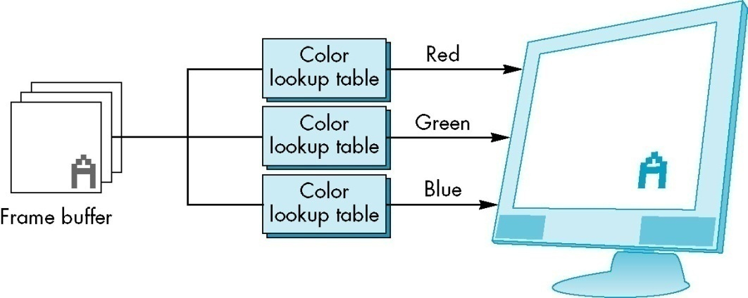
Primitives and Attributes
Indexed Color
  Colors are indexed into tables of RGB values
  Example
    For k=m=8, we can choose 256 out of 16M colors.
glIndex(element);
glutSetColor(color, r value, g value, b value);

Slide 33
OpenGL Viewing
Description
  The viewing is to describe how we would like these objects to appear.
  The concept is just as what we record in a photograph
    Camera Position
    Focal Lens
  View Models
    Orthographic Viewing
    Two-Dimensional Viewing

Slide 34
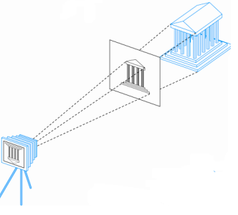
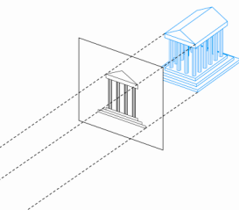
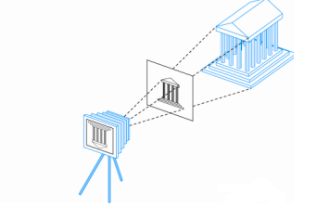
OpenGL Viewing
Orthographic View
  It is the simple and OpenGL’s default view
  It is what we would get if the camera has an infinitely long lens.
  All projections become parallel

Slide 35
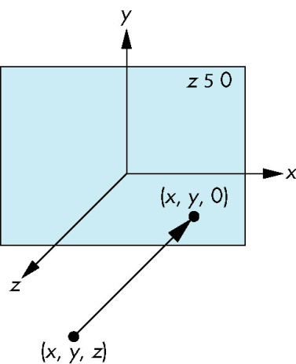
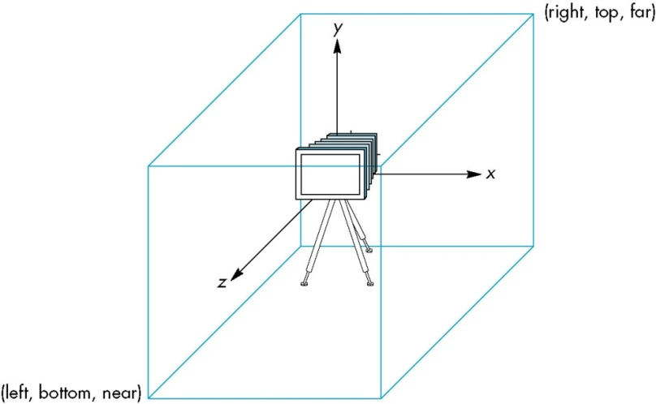
OpenGL Viewing
Orthographic View
  There is a reference point in the projection plane where we can make measurements.
    View Volume
    Projection Direction

Slide 36
OpenGL Viewing
Orthographic View
  The parameters are distances measured from the camera
  It sees only the objects in the viewing volume.
  OpenGL Default
    Cube Volume: 2x2x2
void glOrtho(GLdouble left, GLdouble right, GLdouble bottom, GLdouble top, GLdouble near, GLdouble far)

Slide 37
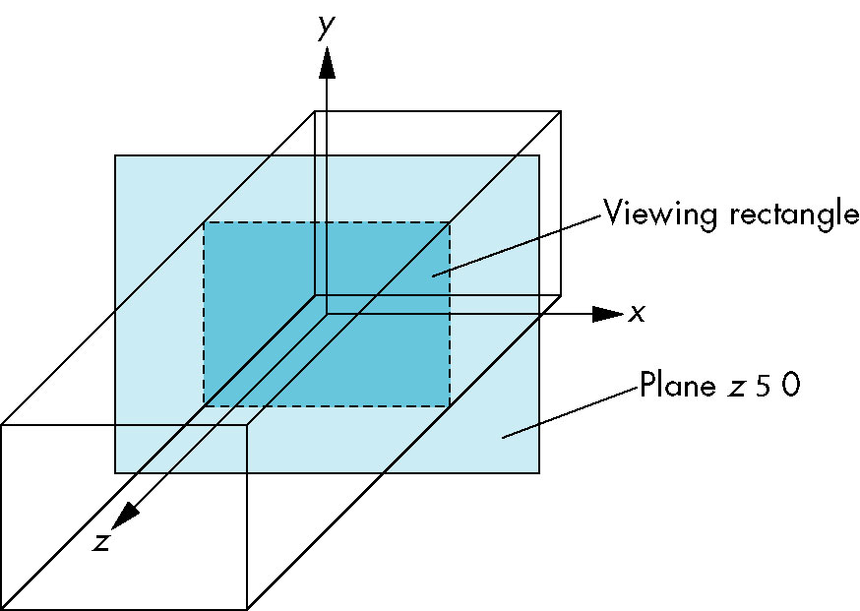
OpenGL Viewing
Two-Dimensional Viewing
  It is a special case of three-dimensional graphics
  Viewing rectangle is in the plane z=0.
void gluOrtho2D(GLdouble left, GLdouble bottom,
GLdouble right, GLdouble top);

Slide 38
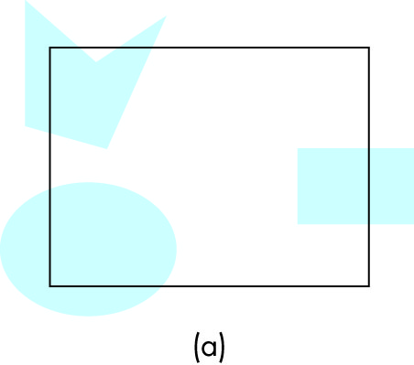
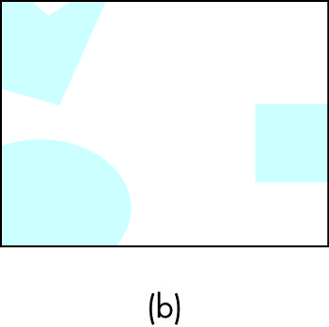
OpenGL Viewing
Two-Dimensional Viewing
  It directly takes a viewing rectangle (clipping rectangle) of our 2D world.
  The contents of viewing rectangle is transferred to the display.

Slide 39

OpenGL Viewing
Aspect Ratio
  It is the ratio of rectangle’s width to its height.
  The independence of the object and viewing can cause distortion effect.
void gluOrtho2D(left, bottom, right, top);
void glutInitWIndowSize(width, height)

Slide 40
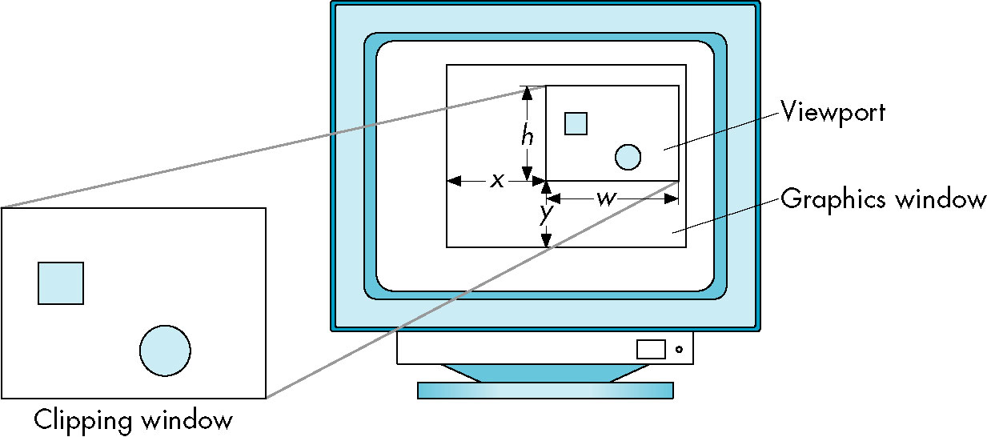
OpenGL Viewing
Aspect Ratio
  The distortion effect can be avoided if clipping rectangle and display have the same ratio.
void glViewport(Glint x, Glint y, Glsizei w, Glsizei h);
(x,y): lower-left corner

Slide 41
Sierpinski Gasket Example
Description
  It is shape of interest in areas such as fractal geometry.
  It is an object that can be defined recursively and randomly.
  The input is the three points that are not collinear.

Slide 42
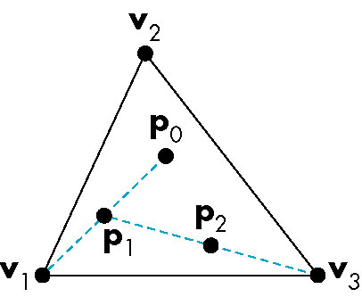
Sierpinski Gasket Example
Construction Process
  Step 1: Pick an initial point inside the triangle.
  Step 2: Select one of the three vertices randomly.
  Step 3: Display a marker at the middle point.
  Step 4: Replace with the middle point
  Step 5: Return to Step 2.

Slide 43
Sierpinski Gasket Example
int main(int argc, char** argv){
  /* initialize the interaction */
  glutInit(&argc, argv);
  glutInitWindowSize(500, 500);
  glutInitWindowPosition(0, 0);
  glutCreateWindow("simple");
  /* set the callback function */
  glutDisplayFunc(myDisplay);
  myInit();
  /* start to run the program */
  glutMainLoop();
}/* End of main */
void myInit(){
/* set colors */
glClearColor(1.0, 1.0, 1.0, 0.0);
glColor3f(1.0, 0.0, 0.0);
/* set the view */
gluOrtho2D(0.0, 50.0, 0.0, 50.0);
}/* End of myInit */

Slide 44
Sierpinski Gasket Example: 2D
void myDisplay(){
/* declare three points */
GLfloat vertices[3][2]={{0.0,0.0},{25.0, 50.0},{50.0, 0.0}};
GLfloat p[2] = {25.0, 25.0};
glClear(GL_COLOR_BUFFER_BIT);
glBegin(GL_POINTS);
for(int k=0; k < 5000; k++){
/* generate the random index */
int j = rand() % 3;
p[0] = (p[0] + vertices[j][0]) / 2;
p[1] = (p[1] + vertices[j][1]) / 2;
glVertex2fv(p);
}/* End of for-loop */
glEnd();
glFlush();
}/* End of GasketDisplay */

Slide 45
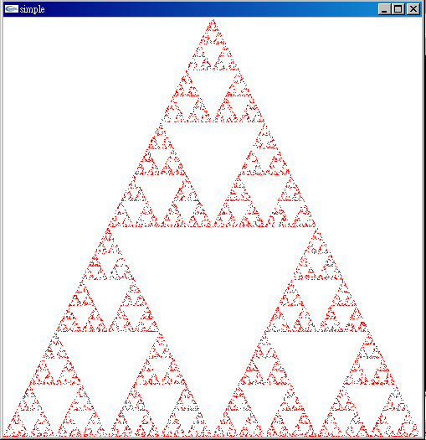
Sierpinski Gasket Example: 2D

Slide 46
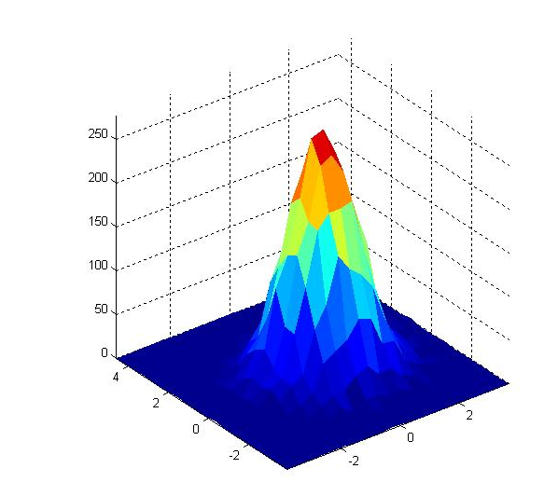
Implicit Function Plotting
What is Implicit Function
  A function equals to a specific value
  It is a contour curves that correspond to a set of fixed values
Cutoff Value

Slide 47
Implicit Function Plotting
Marching Squares
  An algorithm finds an approximation of the desired function from a set of samples.
  It starts from a set of samples

Slide 48
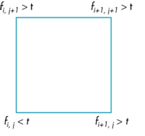
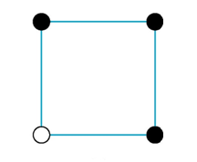
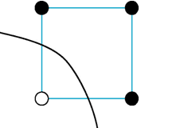
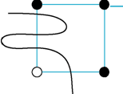
Implicit Function Plotting
Marching Squares
  The contour curves passes through the edge
    One Vertex:
    Adjacent Vertex:
Solution 1
Solution 2
Principle of Occam’s Razor: if there are multiple possible
explanation of phenomenon, choose the simplest one.

Slide 49
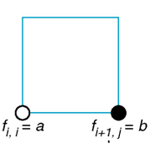
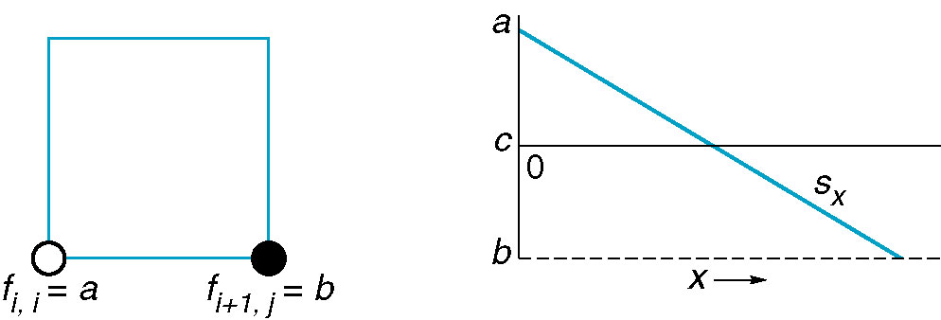
Implicit Function Plotting
Marching Squares
  Intersection Points
    Midpoint
    Interpolation
Halfway
Interpolation

Slide 50
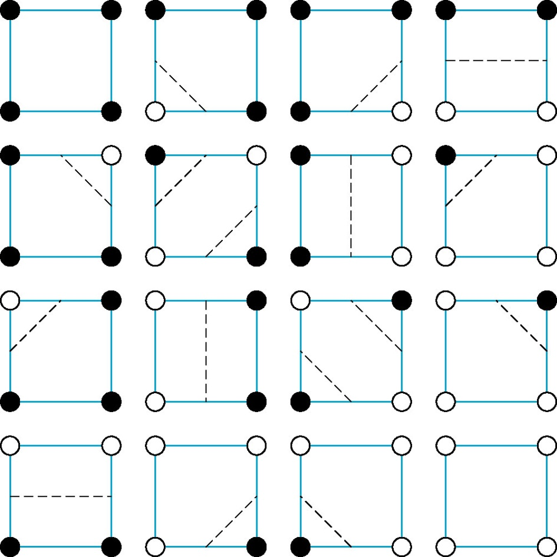


Implicit Function Plotting
Marching Squares
Translation
Inversion
ambiguity
16 possibilities

Slide 51
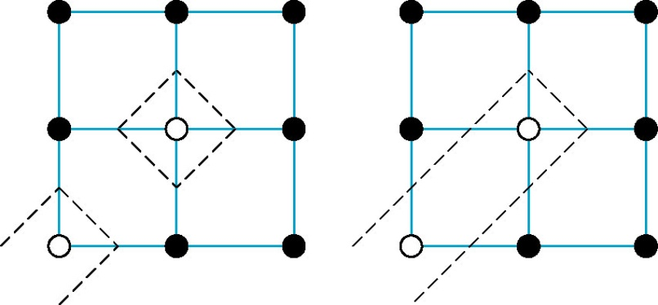
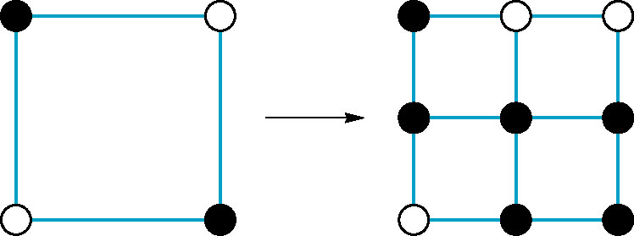
Implicit Function Plotting
Marching Squares
  Ambiguity Effect
    We have no idea to prefer one over the other.
  Ambiguity Resolving
    Subdivide the cell into four smaller cells.
    Analyze these four cells until no ambiguity occurs.

Slide 52
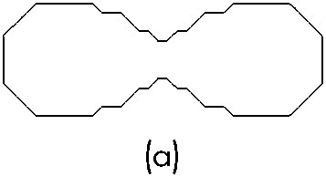
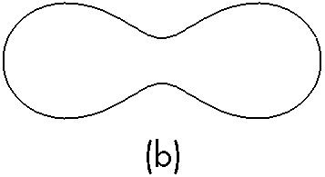
Implicit Function Plotting
Example
Midpoint
Interpolation

Slide 53
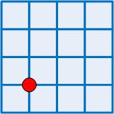
Implicit Function Plotting
void myDisplay(){
/* clear the display */
glClear(GL_COLOR_BUFFER_BIT);
double data[N_X][N_Y];
double sx, sy;
glBegin(GL_POINTS);
for(int i=0; i < N_X; i++)
for(int j=0; j < N_Y; j++){
sx = MIN_X + (i * (MAX_X - MIN_X) / N_X);
sy = MIN_Y + (j * (MAX_Y - MIN_Y) / N_Y);
data[i][j] = myFunction(sx, sy);
glVertex2d(sx,sy);
}/* End of for-loop */
glEnd();
……………
}
N_X=4
(MAX_X,MAX_Y)
N_Y=4
(MIN_X,MIN_Y)
(sx,sy)

Slide 54
Implicit Function Plotting
void myDisplay(){
…………
/* process each cell */
for(int i=0; i < N_X; i++)
for(int j=0; j < N_Y; j++){
int c;
/* check the cell case */
c = cell(data[i][j], data[i+1][j], data[i+1][j+1], data[i][j+1]);
/* drawing lines depending on the cell case */
drawLine(c, i, j, data[i][j], data[i+1][j], data[i+1][j+1], data[i][j+1]);
}/* End of for-loop */
glFlush();
}/* End of GasketDisplay */

Slide 55
Implicit Function Plotting
Example: Implementation
double myFunction(double x, double y){
double a=0.49, b=0.5;
/* compute ovals of cassini */
return (x*x + y*y + a*a)*(x*x + y*y + a*a) - 4*a*a*x*x - b*b*b*b;
}/* End of myFunction */

Slide 56
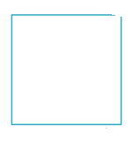
Implicit Function Plotting
Example: Implementation
int cell(double a, double b, double c, double d){
int n=0;
if(a > 0) n = n+1;
if(b > 0) n = n+2;
if(c > 0) n = n+4;
if(d > 0) n = n+8;
return n;
}/* End of cell */
0
1
2
3
d
c
12
13
14
15
a
b

Slide 57
Implicit Function Plotting
void drawLine(int state, int i, int j, double a, double b, double c, double d){
x = MIN_X + (double) i * (MAX_X - MIN_X) / N_X;
y = MIN_Y + (double) j * (MAX_Y - MIN_Y) / N_Y;
halfx = (MAX_X - MIN_X) / (2 * N_X);
halfy = (MAX_Y - MIN_Y) / (2 * N_Y);
x1 = x2 = x;
y1 = y2 = y;
; determine (x1, y1) and (x2, y2)
……………….
glBegin(GL_LINES);
glVertex2d(x1, y1);
glVertex2d(x2, y2);
glEnd();
}/* End of drawLines */
2*halfx
2*halfy
(x,y)

Slide 58
Implicit Function Plotting
void drawLine(int state, int i, int j, double a, double b, double c, double d){
……….
switch(state){
/* draw nothing */
case 0: case 15:
break;
case 1: case 14:
x1 = x; y1 = y + halfy;
x2 = x + halfx; y2 = y;
break;
case 2: case 13:
x1 = x + halfx; y1 = y;
x2 = x + halfx * 2; y2 = y + halfy;
break;
}/* End of switch */
…………
}/* End of drawLines */
(x1,y1)
(x2,y2)

Slide 59
Thank You !

